Slide 1
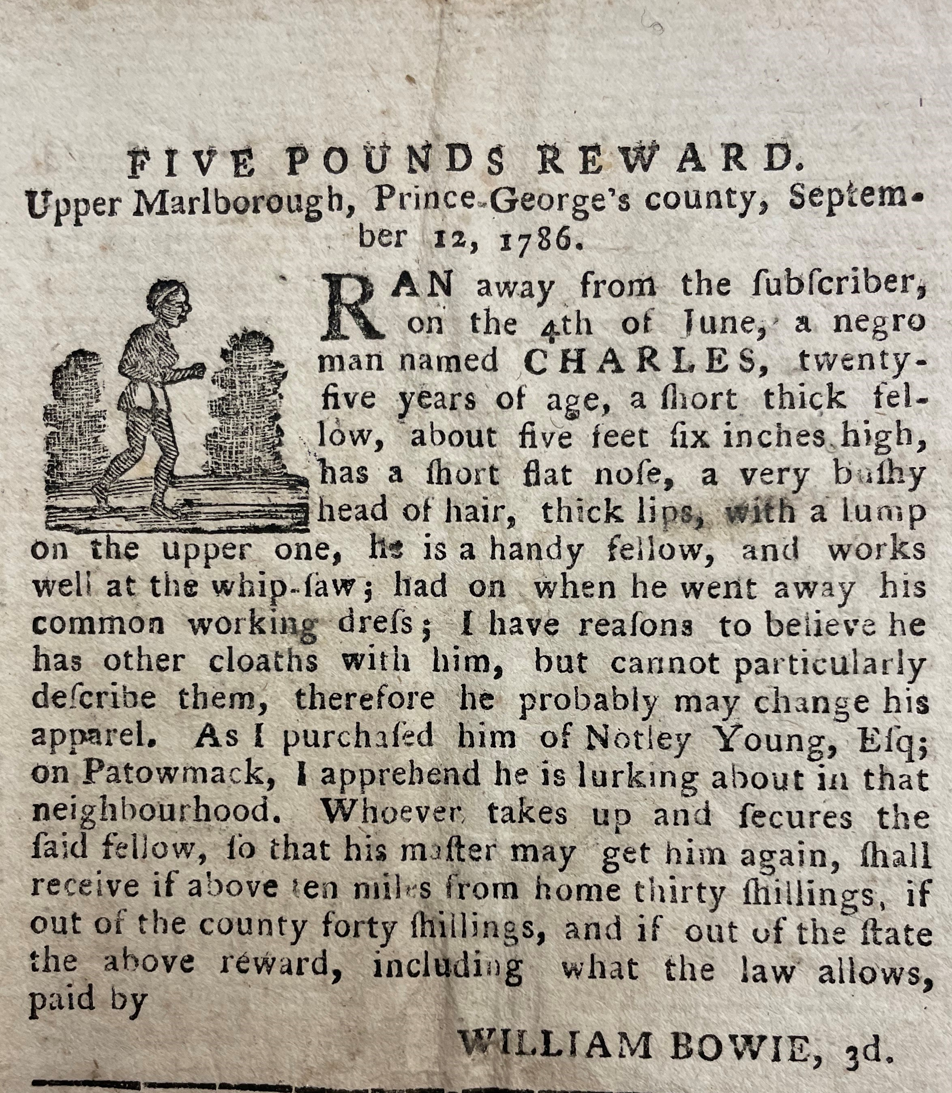
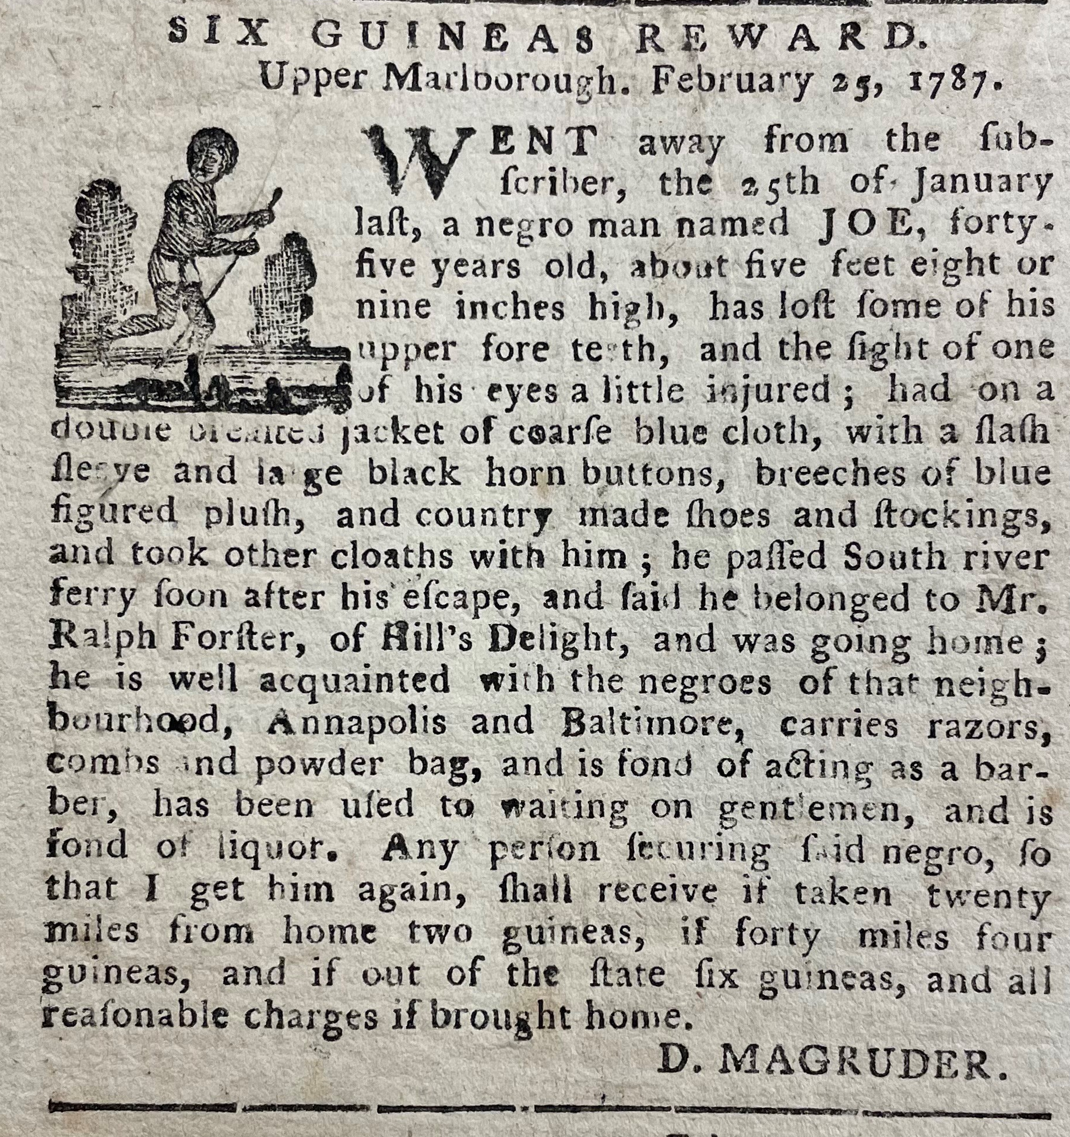

Freedom Seeker writing assignment

Slide 2
reading runaway advertisements
Clothing
Hair
Naming
Language & communication
Comportment and gestures (kinesics)
Slavery marks
African marks

Slide 3
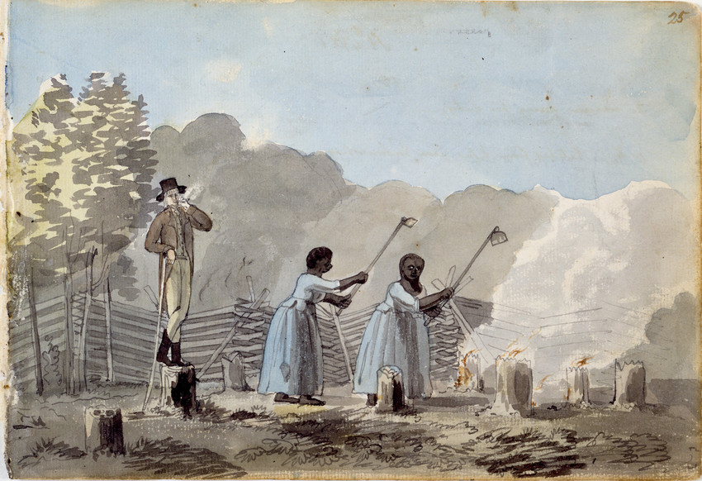
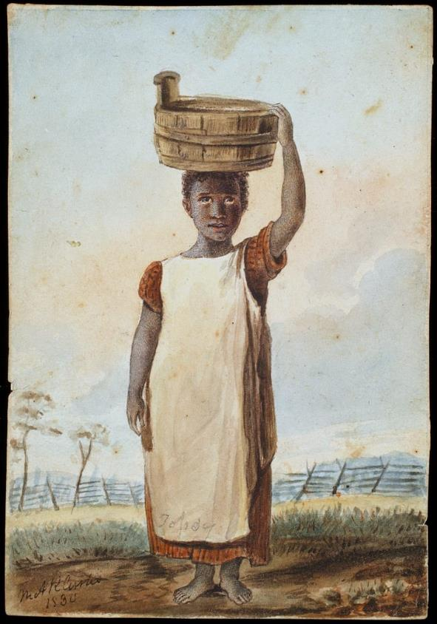
Clothing
Benjamin Latrobe,
An Overseer doing his duty,
Maryland (1798)
Mary Custis, Enslaved girl,
Virginia (1830)
Colonial Williamsburg

Slide 4
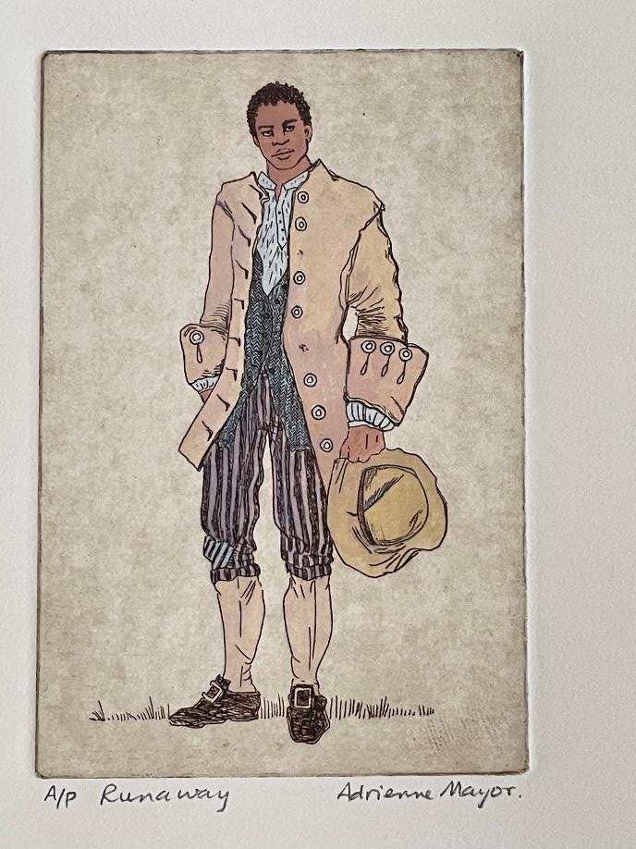
Clothing
American Weekly Mercury (Philadelphia),
August 20, 1730

Slide 5
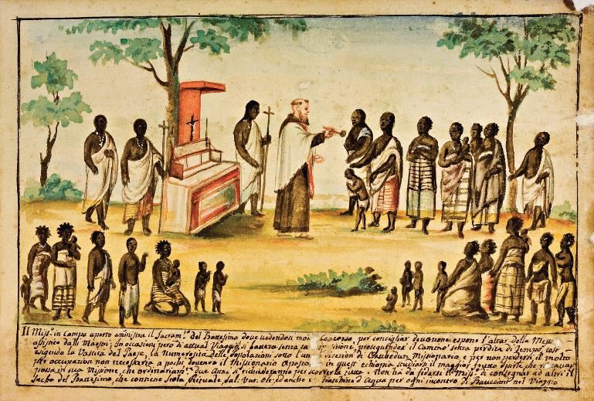
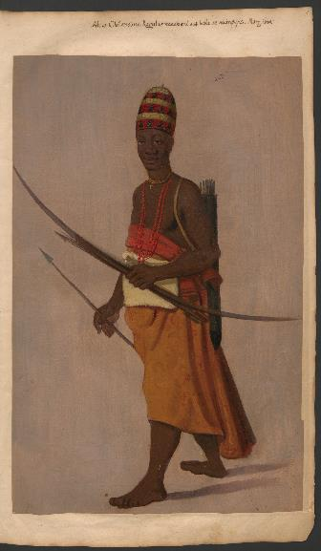
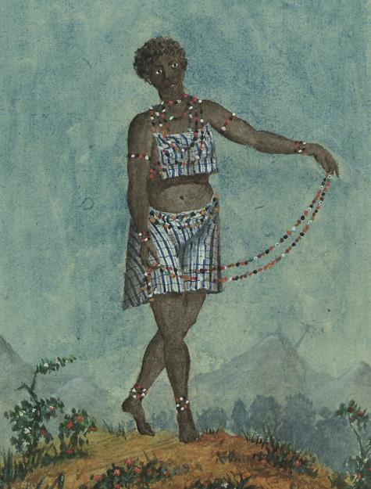
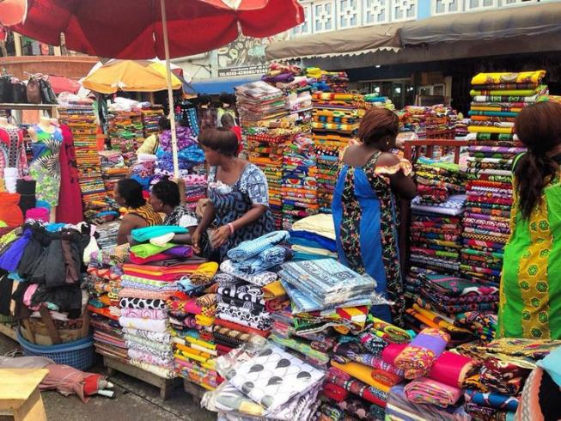
West African
Clothing
Bernardino d'Asti, The Missionary Administers
Baptism Outdoors, c. 1750. Watercolour on paper,
19.5 × 28 cm. Turin: Biblioteca Civica Centrale
(MS 457, f. 7r).
Louis Marie Joseph de Grandpré, Woman from Malemba,
c. 1786–87. Watercolour on paper, 29 × 22.5 cm.
Lisbon: Biblioteca Nacional de Portugal (MS 242, n.
102, f. 4).
Albert Eeckhout, Portrait of
Kongo Ambassador to Recife,
c. 1637–44.
Krakow: Jagiellonian
Library (Libri Picturati
34, f. 5).
Market in Accra,
Ghana (2007)

Slide 6
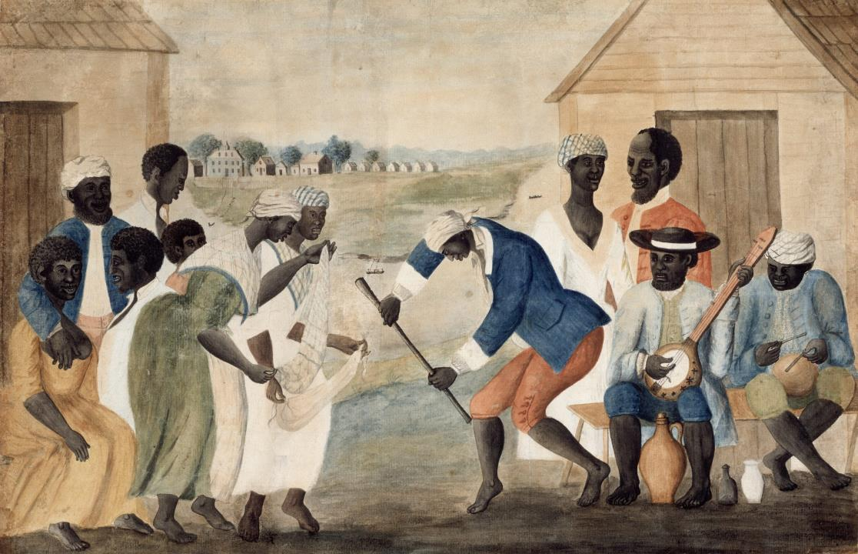
Clothing
John Rose, “Plantation Dance, South Carolina,” (1785-95) (Colonial Williamsburg)

Slide 7
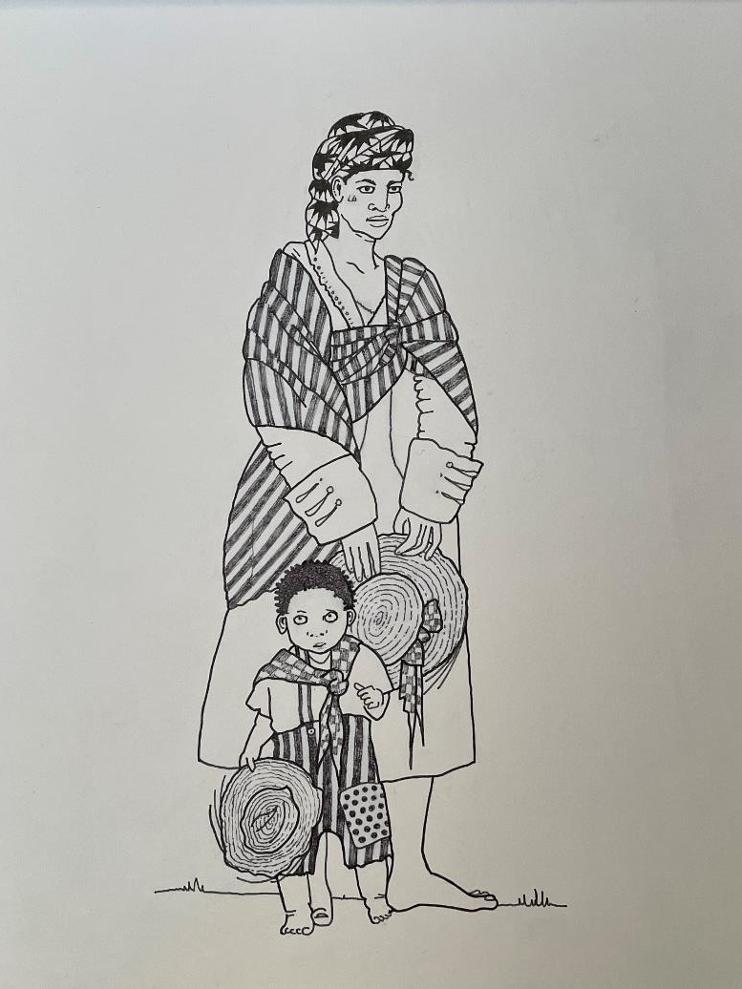
Clothing
Adrienne Mayor’s image of Dorah and her
three-year old son, whose escape was
advertised in the South Carolina Gazette
On 2 September 1748.
The clothing is based on descriptions in
several advertisements found in the
South Carolina Gazette in this period, during
which many (perhaps even a majority) of
enslaved people had been born in Africa.

Slide 8
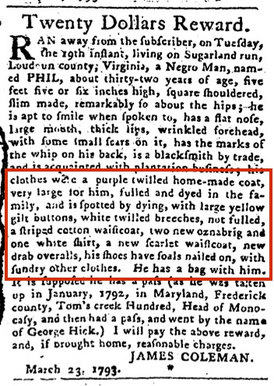
Clothing
Pennsylvania Gazette
(Philadelphia)
May 29, 1793

Slide 9
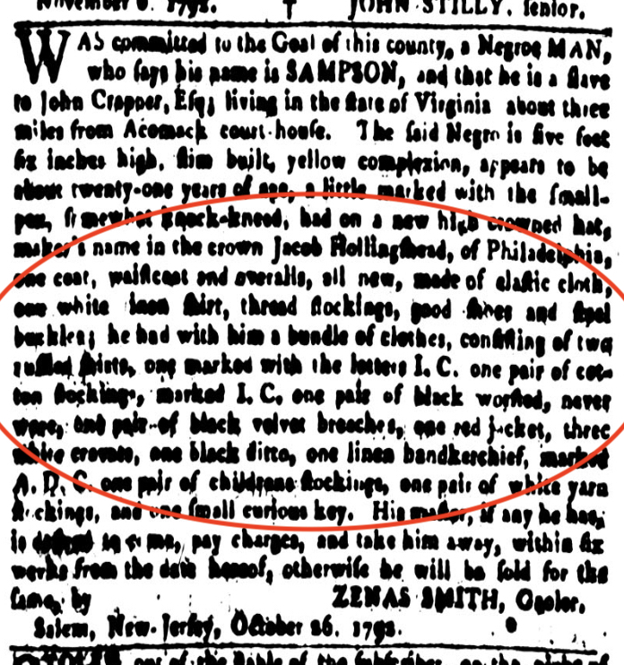
Clothing
Pennsylvania Gazette
(Philadelphia)
November 7, 1792
“Sampson… had on a new high crowned hat, maker’s
name in the crown Jacob Hollingshead, of Philadelphia,
one coat, waistcoat and overalls, all new, made of elastic
cloth, one white linen shirt, thread stockings, good shoes
and steel buckles; he had with him a bundle of clothes,
consisting of two ruffled shirts, one marked with the
letters I.C. [the initials of his master, John Crapper] one
pair of cotton stockings, marked I.C. one pair of black
worsted, never wore, one pair of black velvet breeches,
one red jacket, three white cravats, one black ditto, one
linen handkerchief, marked A.D.C. one pair of children’s
stockings, one pair of white yarn stockings.”

Slide 10
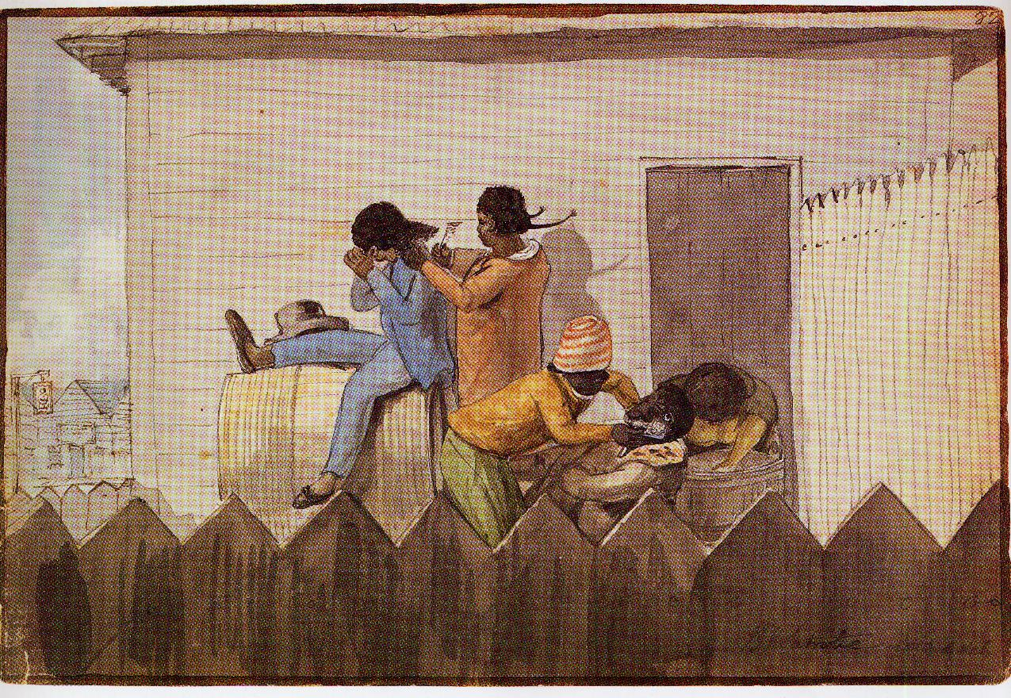
Hair
Henry LaTrobe, “Barbers, Norfolk, Virginia,” (1797) Maryland Historical Society

Slide 11
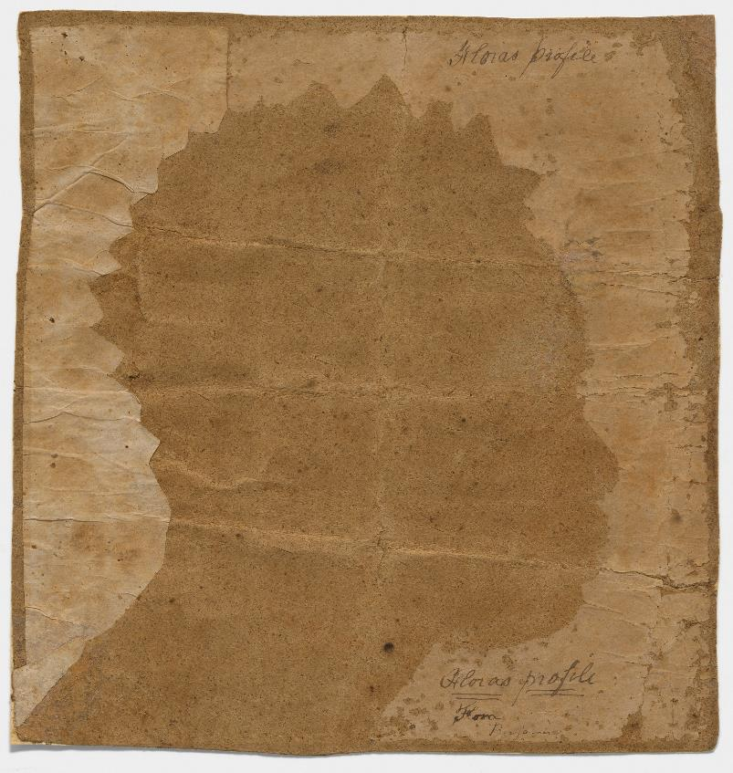
Hair
Silhouette of Flora (1796),
Smithsonian, Washington DC

Slide 12
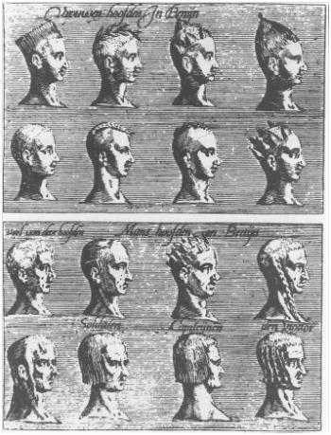
Hair
Pieter de Marees, “Women's & Men’s
Heads in Benyn, 1602,’ showing diversity
of hairstyles in one region of West Africa.

Slide 13
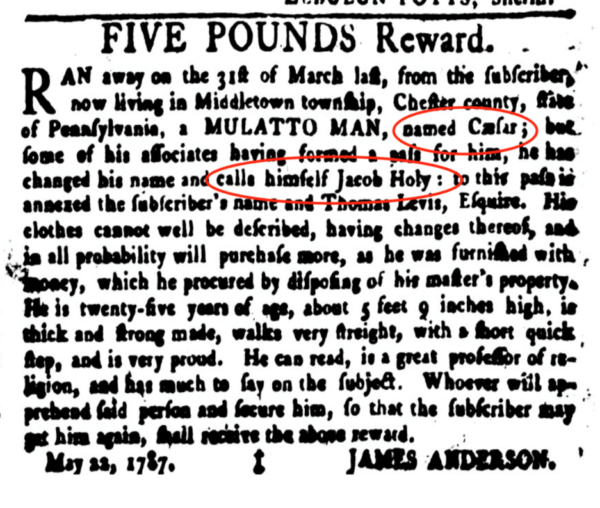
naming
Pennsylvania Gazette
(Philadelphia) March 31
1787

Slide 14
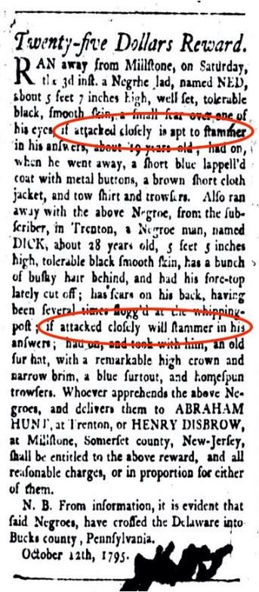
Language & communication
Pennsylvania Gazette
(Philadelphia)
October 21, 1795

Slide 15
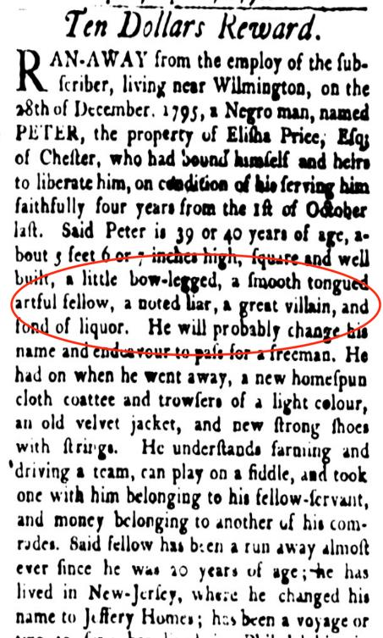
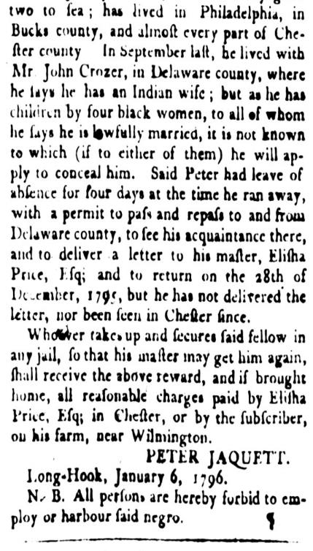
Language & communication
Pennsylvania Gazette
(Philadelphia)
April 13, 1796

Slide 16
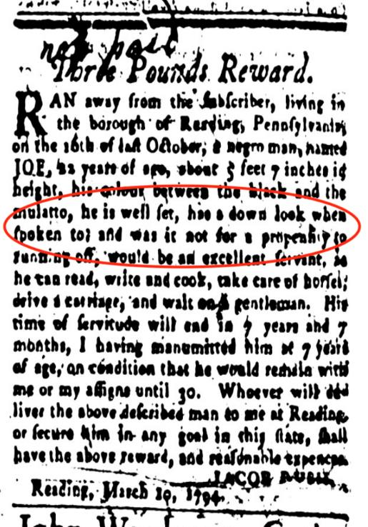
Comportment & gesture (kinesics)
Pennsylvania Gazette
(Philadelphia)
March 19, 1794

Slide 17
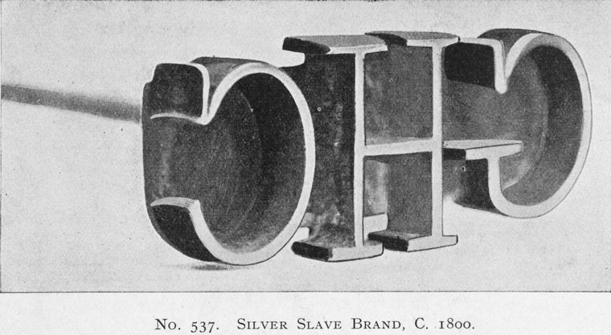
Slavery marks
Silver slave brand
(ca. 1800),
New York Public Library

Slide 18
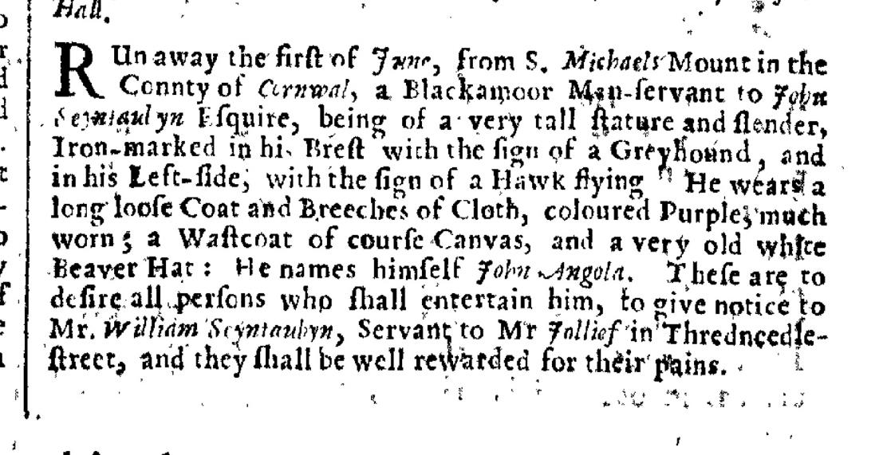
Slavery marks
London Gazette (London),
June 22, 1674

Slide 19
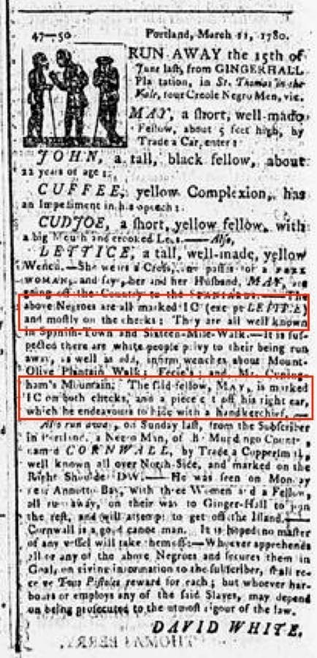
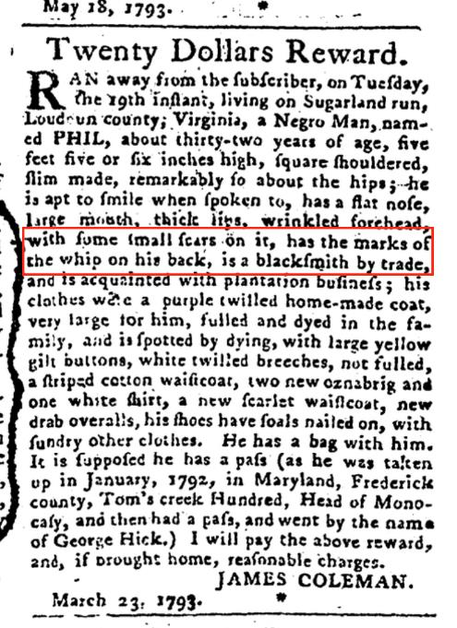
Slavery marks
Royal Gazette
(Kingston, Jamaica),
April 8, 1780
“The above Negroes are all marked IC (except LETTICE) and mostly on the cheeks… The Field fellow, MAY, is marked IC on both cheeks, and a piece cut off his right ear, which he endeavours to hide with a handkerchief…”
Pennsylvania Gazette (Philadelphia), May 29, 1793

Slide 20
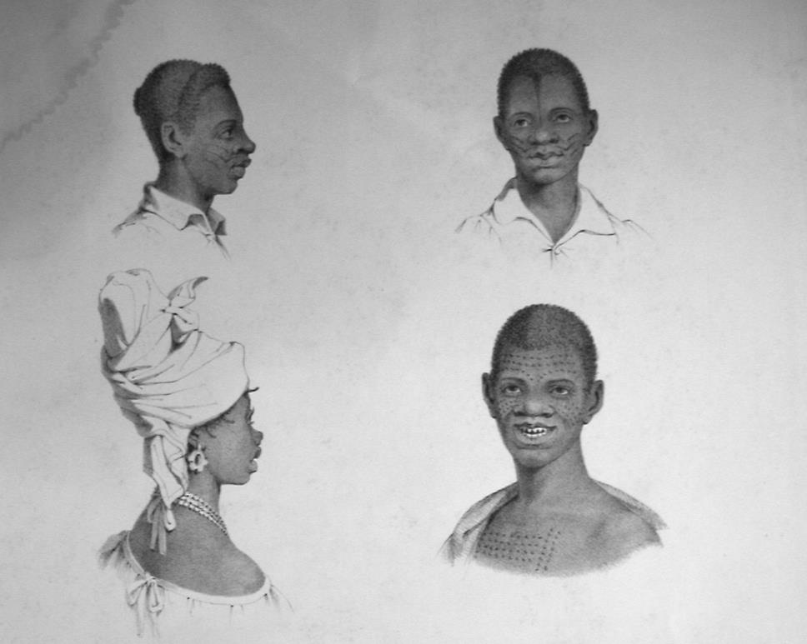
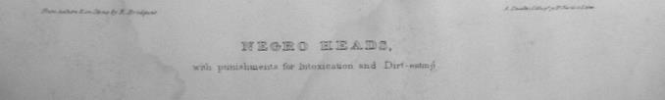
African marks
(often known as
“country marks”)
Richard Bridgens,
“Negro” [African]
Heads” (1836)

Slide 21
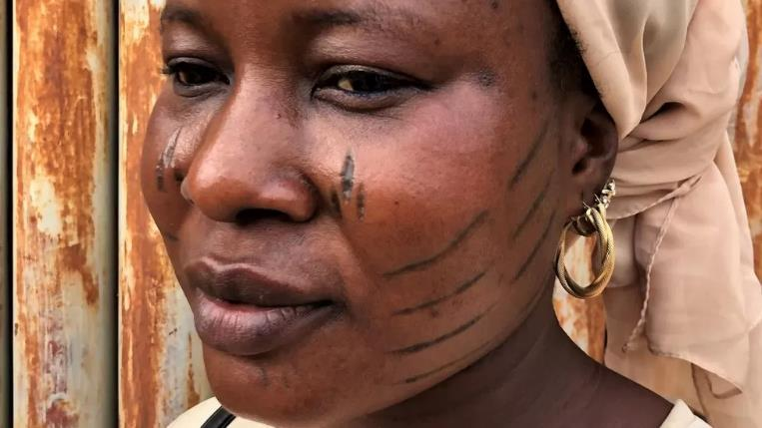
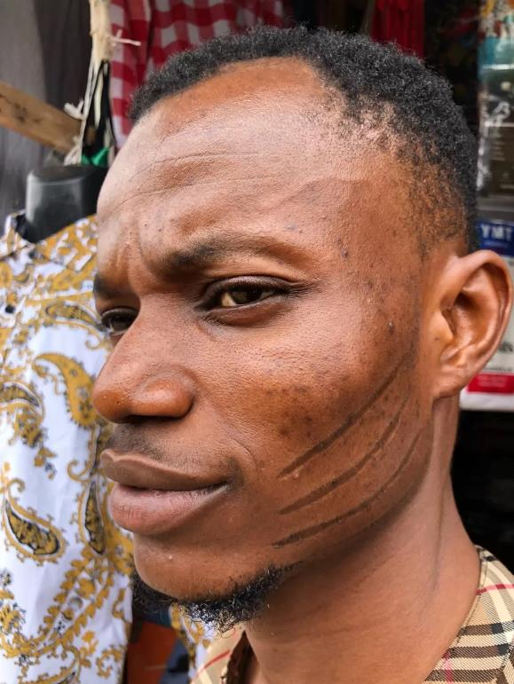
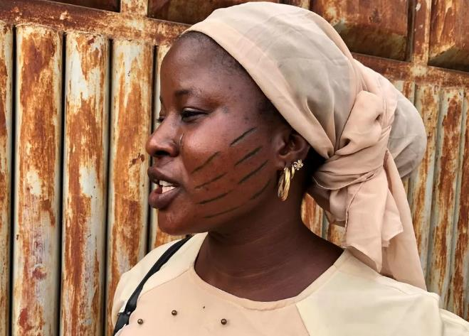
African marks
Nigerian scarification, BBC News, May 2022

Slide 22
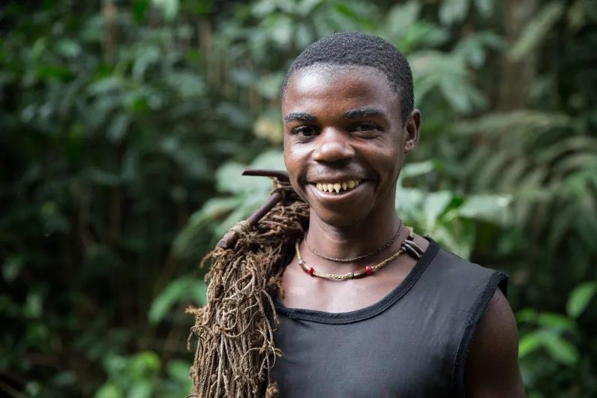
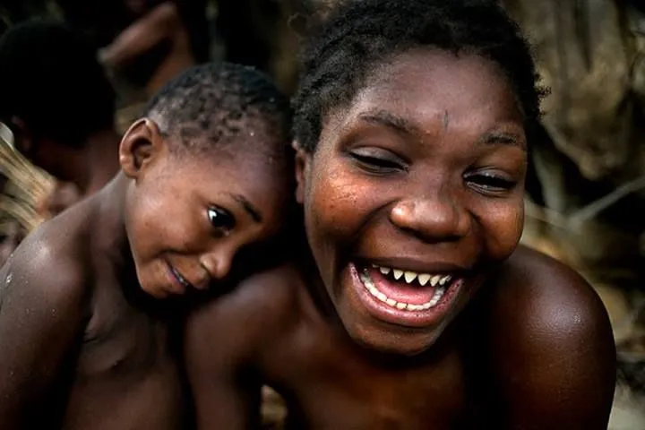
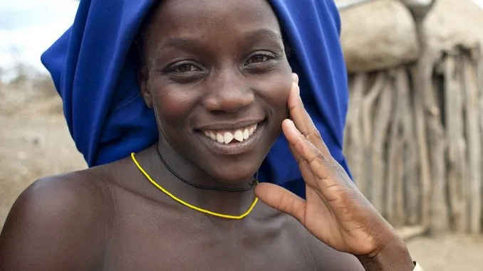
African marks
“Teeth Sharpening Culture in Africa,” Hadithi Africa, February 2020

Slide 23
Things to consider:
Names
Language/communication
Comportment & gestures (kinesics)
Supposed character
Clothing
African marks
Hair
Slavery marks
Motives for escape
Destination
Other?

