Slide 1

Freedom Seeker case study 2
Cuff Dix, Pennsylvania, 1776

Slide 2
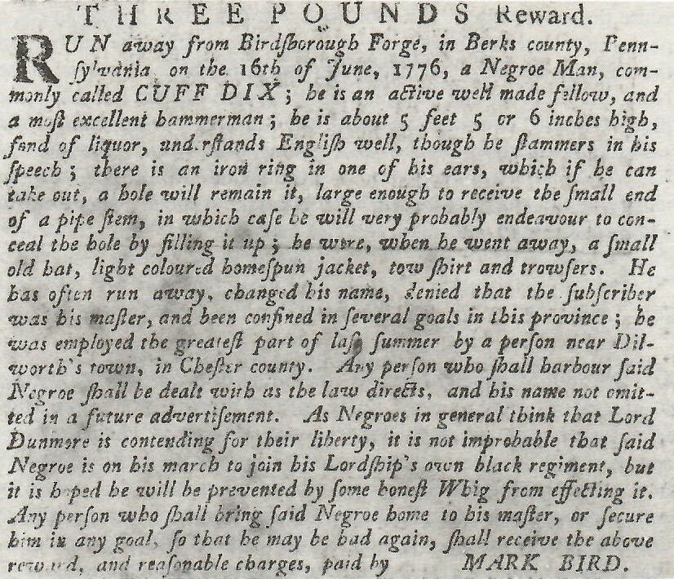
Cuff Dix
Pennsylvania Gazette (Philadelphia)
July 17, 1776
Located in America’s Historical Newspapers,
https://digital.library.wisc.edu/1711.web/earlyamernews

Slide 3
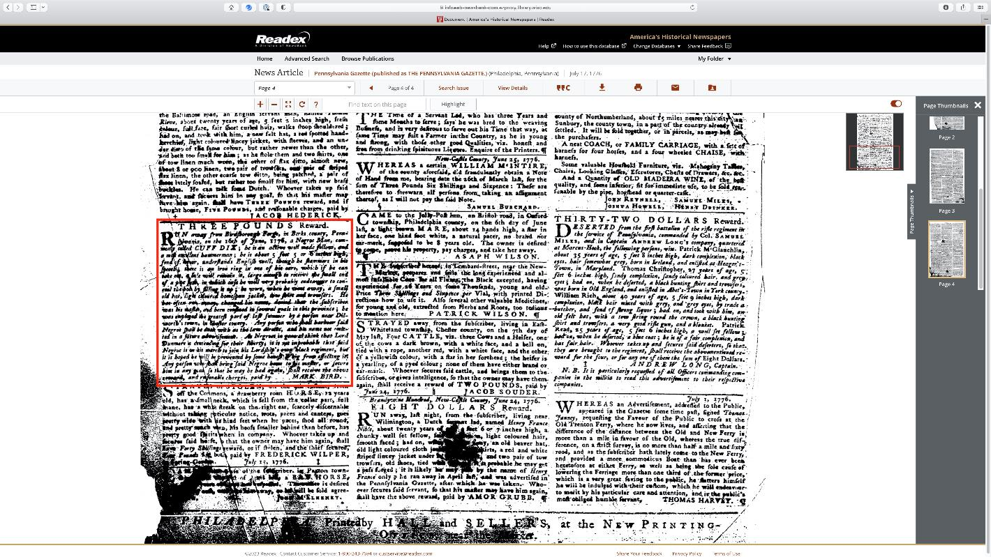
This advertisement is in the
Pennsylvania Gazette in
‘America’s Historical
Newspapers.’ It appears near
the bottom of page 4 of the
issue printed on July 17, 1776
(the newspaper appeared twice
a week).

Slide 4
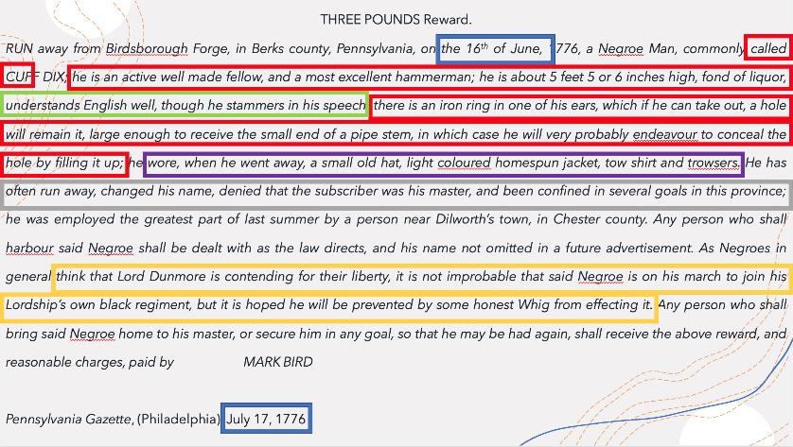
If we look carefully at the text of the advertisements, a number of things stand out.
First, dates: Cuff Dix escaped just over two weeks before the Declaration of Independence, and this advertisement appeared just under two weeks after the Declaration. There is a paradox here: the Declaration was an affirmation of Americans’ right to freedom and self-determination, but clearly White Americans saw no problem in keeping people enslaved.
Then we have the names of the freedom seeker, references to his professional skills and characteristics of the freedom seeker as described by his enslaver.
A £3 reward was offered by Mark Bird, apparently owner and operator of Birdsborough Forge, an ironworks in Berks County, PA, where at least one and probably several enslaved people work, including Cuff Dix.
Cuff Dix, has a first and last name, suggests identity beyond that of single name imposed by enslaver. Cuff is an unusual name, and may well be an abbreviation of Cuffee, a West African name: this is the first clue that Dix may have been born in Africa.
Bird described Dix as “Active and well made,” and he was clearly a fit and healthy working man. He was also a “Most excellent hammerman” in a forge, i.e. a skilled blacksmith
He wore an African-style ring in ear (an ear-stretching spacer that created a large hole in the lobe of his ear): this is another indication of possible African birth, since this was a West African practice.
With regard to language, Bird suggests that Dix “understands English well.” This is not something Bird would have written if Dix had been born in America and raised speaking English: this is the third and perhaps clearest indication that Dix had been born in Africa.
Bird also mentions that Dix stammered: this might possibly reflect the power-dynamic between enslaver and enslaved.
The clothing Dix was wearing was the basic, simple clothing of an enslaved working man. It was summer when he escaped, and the heavy clothing needed during winter was unnecessary.
Bird wrote in this advertisement that Dix had often run away, changed his name, denied that he was enslaved, and then been captured and imprisoned. Clearly, Dix was a man determined to achieve freedom.
Bird notes that ss enslaved people think “Lord Dunmore is contending for their liberty” Dix may have gone to join “his Lordship’s own black regiment.” But, Bird concludes, he hoped that “some honest Whig” will recapture Dix: an “honest Whig” is a reference to an American revolutionary Patriot, a person committed to the American cause against Britain. Here again is evidence of the paradox of liberty in 1776.

Slide 5
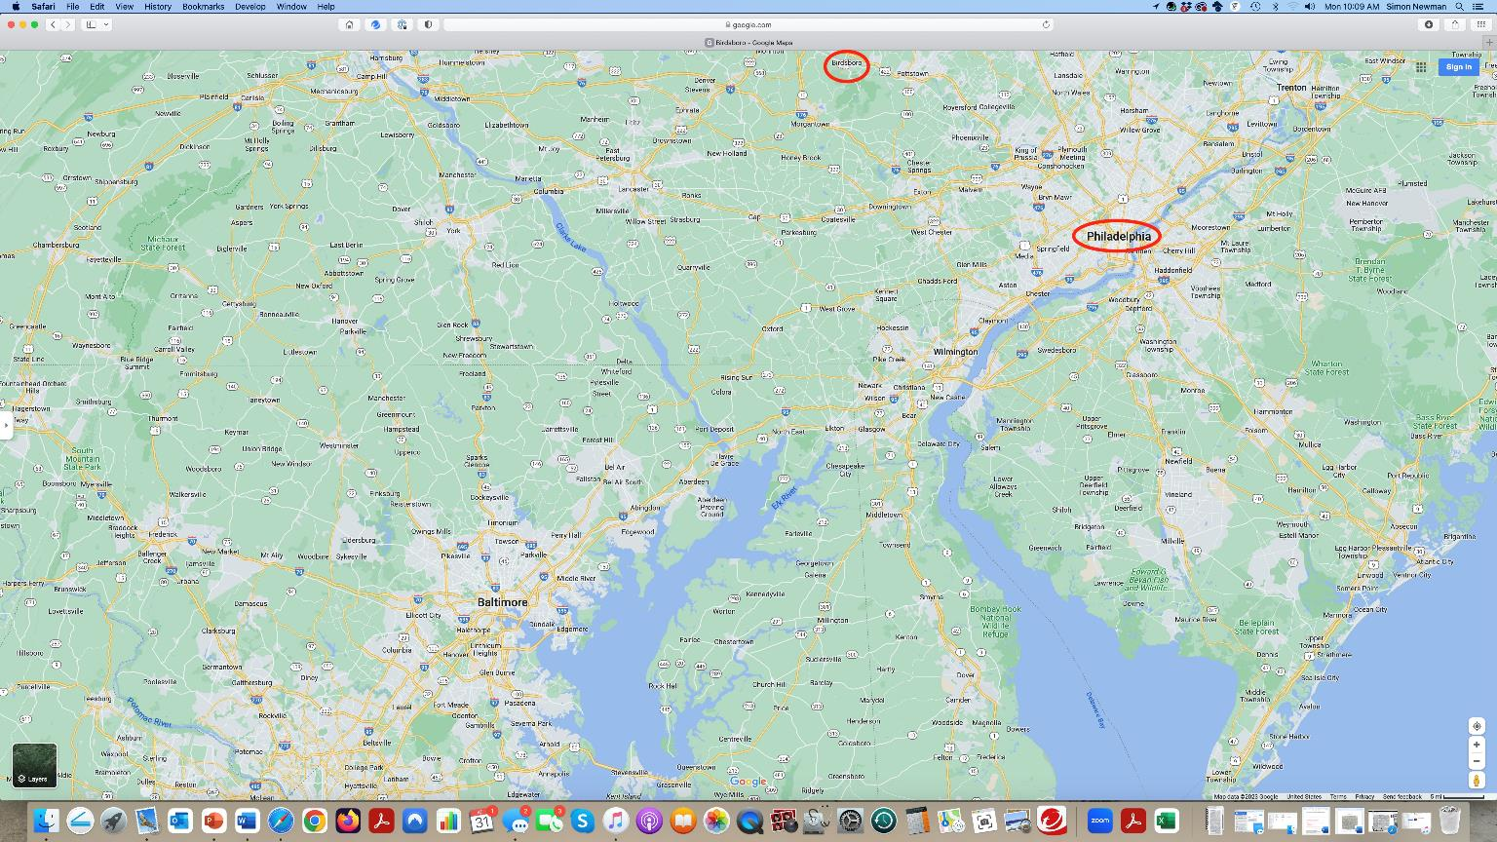
A search for Birdsborough, PA on google maps reveals the location of the township and forge from which Cuff Dix escaped,
and we can see it is about 40 miles north west of Philadelphia.

Slide 6
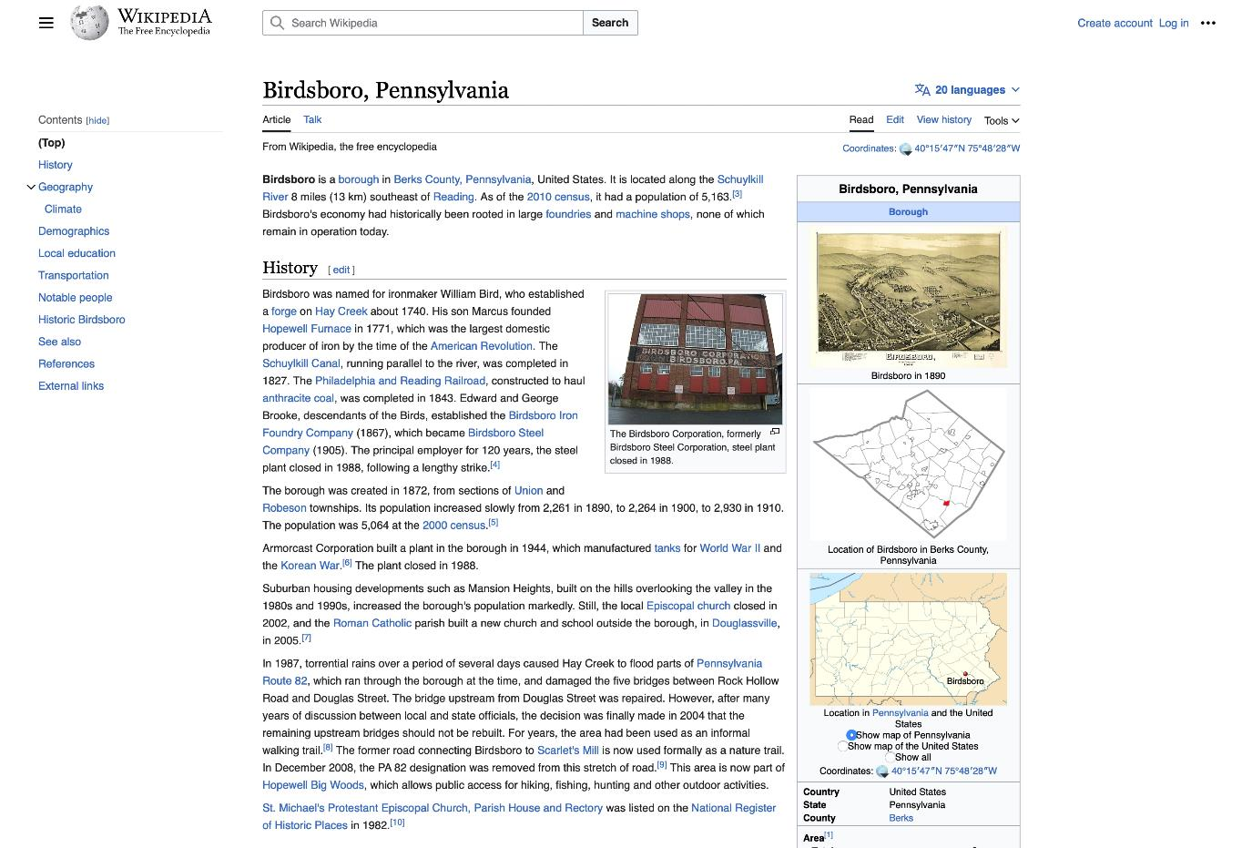
What about Dix’s enslaver, Mark
Bird, and the Birdsborough Forge?
A simple google search for
Birdborough, Pennsylvania reveals
a Wikipedia page (and other
pages) that show the township had
been founded by William Bird,
who established a forge there in
about 1740. It is clear the Bird
family were major producers of
iron in 18th century Pennsylvania,
at Birsboro and Hopewell, both
in Pennsylvania.

Slide 7
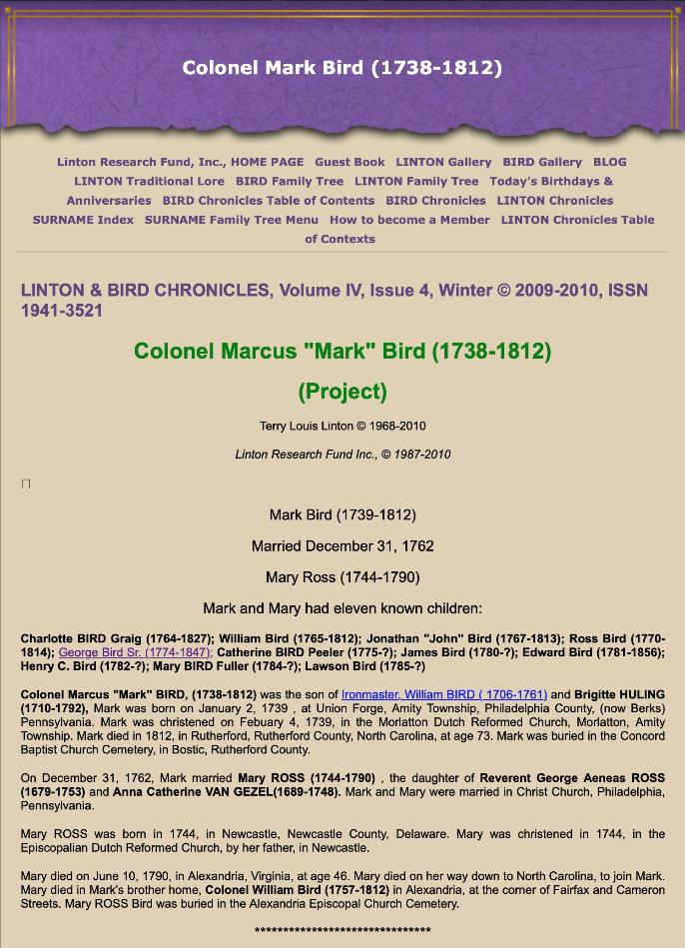
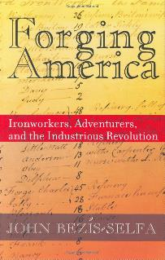
Google search for [“Mark Bird” AND “Birdsboro Forge”]
John Bezis-Selfa, “A Tale of Two Ironworks: Slavery, Free Labor, Work,
and Resistance in the Early Republic,” The William and Mary Quarterly,
3d Series, 56 (October 1999): 677-700.
Forging America: Ironworkers,
Adventurers, and the Industrious
Revolution (Ithaca: Cornell University Press, 2004)
A google search for “Mark Bird” AND “Bidsboro Forge”
results in a number of hits, including one with excerpts from
a booklet about the Bird family history, and an article and a
book by John Bezis-Selfa.

Slide 8
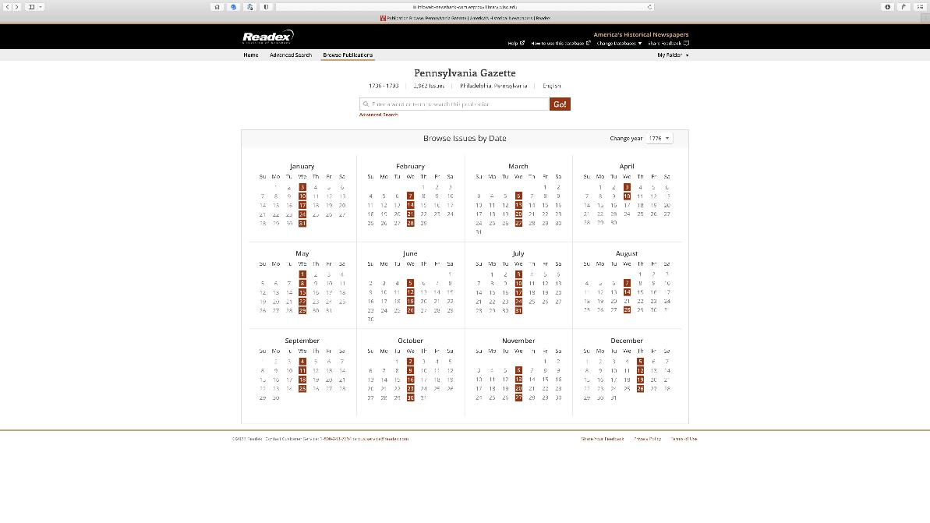
The advertisement indicated that Cuff Dix had “often” run away, and had sometimes been confined
to jail when recaptured. Since these escape attempts may well have resulted in Mark Bird placing
other newspaper advertisements, you can go back to the ‘America’s Historical Newspapers’ database
(or other collections of advertisements), and then search and browse through earlier issues of the
Pennsylvania Gazette and scan the advertisements for any mention of Cuff Dix and Mark Bird.
All of this can be done online, and as you get used to scanning the newspapers you can do this quite
quickly. Since the advertisement we started with was dated July 17, 1776, you can go backwards from there.

Slide 9
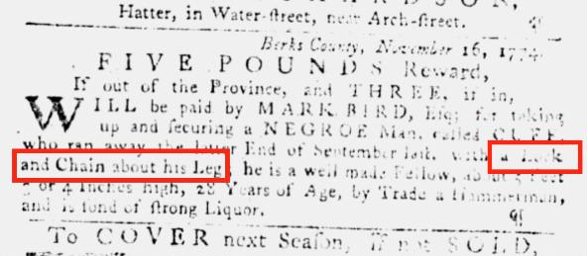
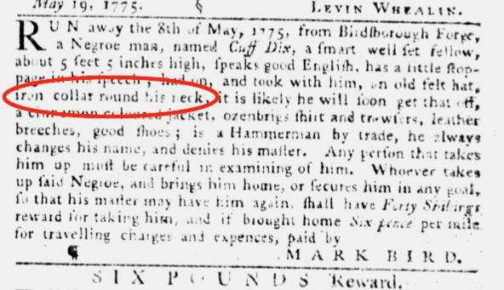
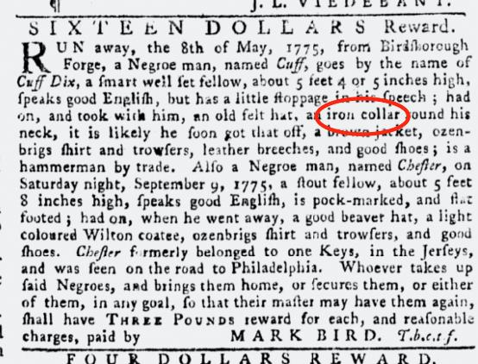
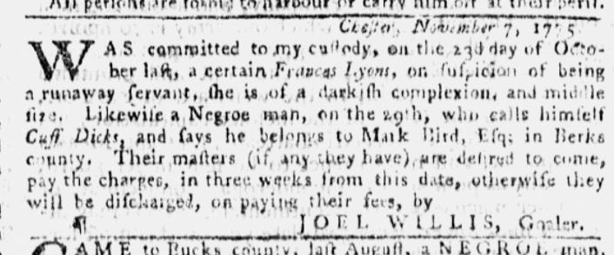
Quickly you find more advertisements
Cuff Dix escaped in November 1774,
and was then presumably recaptured.
He escaped again in May 1775, and
apparently remained free for some time
because another advertisement appeared
in October of that year, by which time
he had been free for five months. He
was then captured by the keeper of the
jail in Chester, who advertised this, and
presumably Mark Bird came to Chester
to collect Dix. Google maps reveals that
Chester is on the Delaware River south-east
of Philadelphia, and about 45 miles south of
Birdsboro). Notice how in several of these
advertisements Bird specified that he had
tried to restrict Cuff Dix’s movements by
placing a lock and chain on his leg, or an
iron collar locked around his neck. If you
read a little about slave collars, chains etc.,
you find out that these were used as
punishment, to restrict movement, and to
prevent people from trying to escape:
clearly Mark Bird was trying to prevent
Cuff Dix from escaping.
Pennsylvania Gazette, Nov 23, 1774
Pennsylvania Gazette, May 24, 1775
Pennsylvania Gazette, Oct 11, 1775
Pennsylvania Gazette, Nov 15, 1775
Notes:
There may be more, but these are the advertisements I discovered. Cuff Dix escaped in November 1774, and was then presumably recaptured. He escaped again in May 1775, and apparently remained free for some time because another advertisement appeared in October of that year, by which time he had been free for five months. He was then captured by the keeper of the jail in Chester, who advertised this, and presumably Mark Bird came to Chester to collect Dix. Chester is on the Delaware River south-east of Philadelphia, and about 45 miles south of Birdsboro).

Slide 10
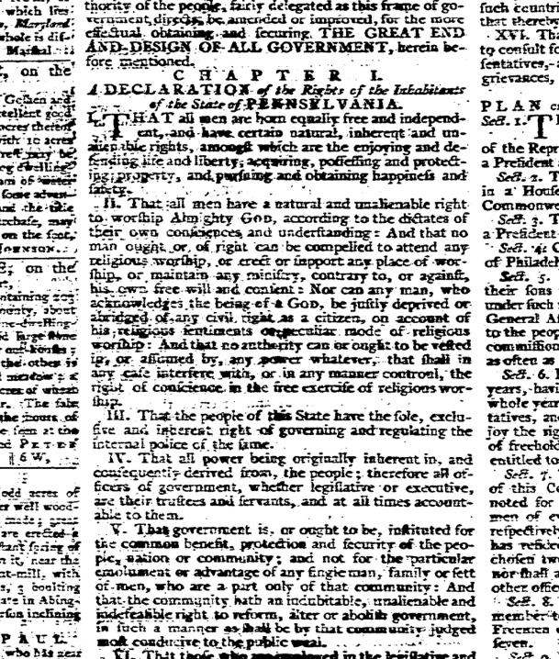
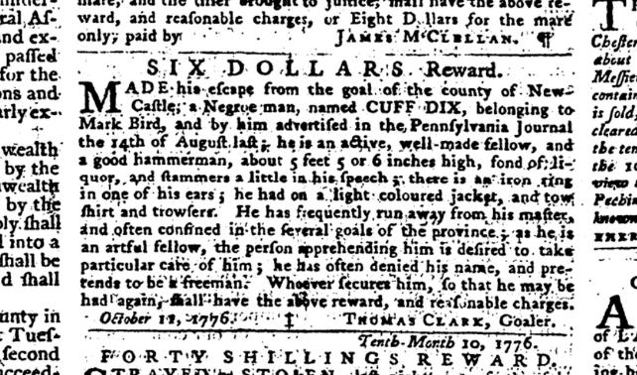
Pennsylvania Gazette (Philadelphia), October 16, 1776
It is also useful to look at the advertisements for the few months after the
July 17 advertisement, and this revealed one more mention of Cuff Dix.
On October 6 the jail keeper in Newcastle, Delaware reported that Cuff
Dix had been captured but then had escaped. On the front page of this
newspaper the new “Declaration of the Rights of the Inhabitants of the State
of Pennsylvania” appeared, beginning with the stirring declaration “That all men are born equally free and independent, and
have certain natural, inherent and unalienable rights, among which are the enjoying and defending life and liberty…”
Clearly there is a stark contrast between an enslaved man like Cuff Dix and White Pennsylvanians who were fighting against
Britain for their freedom. Newcastle, Delaware was nearly 50 miles south of Birdsboro. Like Chester it was on the Delaware
River, heading towards the ocean.

Slide 11
Pennsylvania Gazette (Philadelphia)
July 17, 1776
Located in America’s Historical Newspapers,
https://digital.library.wisc.edu/1711.web/earlyamernews
So how and where was Cuff Dix seeking to secure
his own freedom? Remember the July 1776
advertisement with which we started suggested that
Dix and other enslaved people believed that
“Lord Dunmore is contending for their liberty” and
that consequently Dix might be making his way to
join “his Lordship’s own black regiment”.

Slide 12
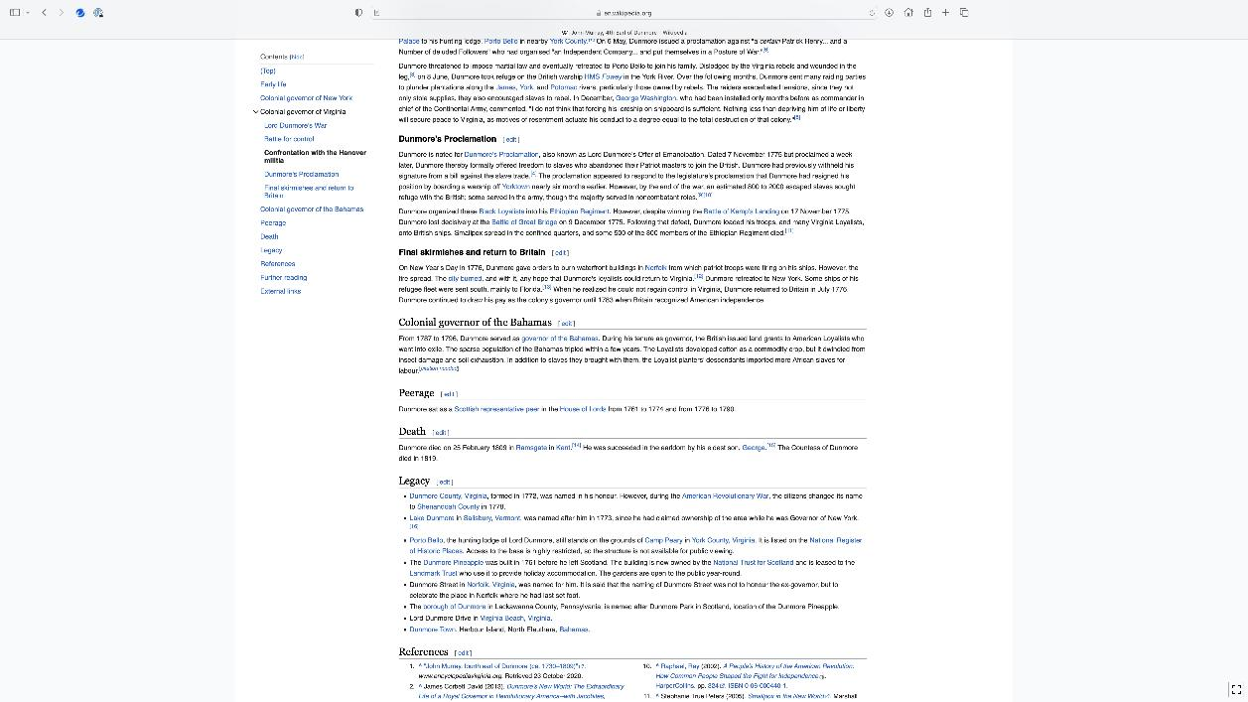
Google search for “Lord Dunmore”
A quick google search for “Lord Dunmore” yields a large number of entries, and looking at these reveals why Dunmore was important.
As you can see in this Wikipedia entry, Dunmore was a British army general who in 1771 was appointed by King George III to reassert royal control over the increasingly rebellious colony of Virginia. However, as Dunmore felt control of the colony slipping away from him, he took a dramatic and radical step. In November 1775 he issued a
proclamation promising freedom to any enslaved people who ran away from their enslavers and joined his military forces. Immediately enslaved people started escaping to Dunmore, and he organized these into what were known as his “Ethiopian Regiment.”
Remember that Cuff Dix had been recaptured once at Chester, Pennsylvania, and then again at Newcastle, Delaware. Both were on the route towards the Chesapeake Bay area where Dunmore and his forces were located.

Slide 13
Resources on Dunmore & enslaved people who ran to British forces
The footnotes to the Wikipedia article on Dunmore, as well as a search of a library catalog, reveal plenty of academic works about Dunmore and the enslaved people who joined him, including works like these.
Simon Schama, Rough Crossings: Britain, the slaves and the American revolution (New York: Harper Collins, 2006).
Cassandra Pybus, Epic Journeys of Freedom: runaway slaves of the American Revolution and their global quest for liberty (Boston: Beacon Press, 2007).
Benjamin Quarles, “Lord Dunmore as Liberator,” The William and Mary Quarterly, 3rd. ser., 15 (1958), 494-507.
Cassandra Pybus, “Jefferson’s Faulty Math: The Question of Slave Defections in the American Revolution,” William and Mary Quarterly, 3d. ser., 62 (2005), 248-50.

Slide 14
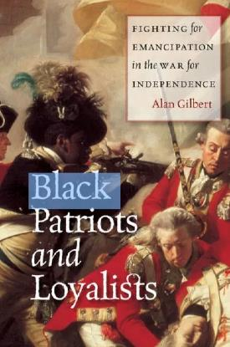
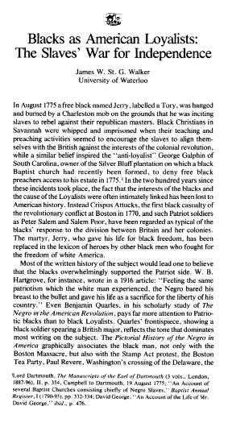
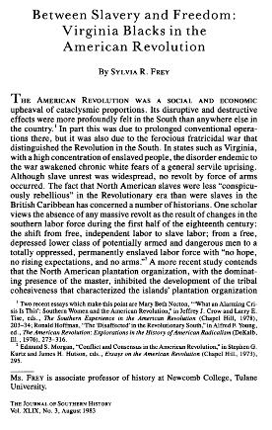
What does Cuff Dix’s story tell us?
So what does this all of this mean? In the months during which the Second
Continental Congress issued the Declaration of Independence, and the new
nation began fighting a long war for independence, enslaved Africans like
Cuff Dix believed that their greatest chance of achieving personal independence
would come by escaping from their American enslavers and joining the forces
of George III.
It is interesting that in his advertisement Mark Bird wrote that “Negroes in general
think that Lord Dunmore is contending for their liberty,” which indicates that
enslaved people were all too well aware of what was going on in America’s fight for
independence, and how it might potentially affect them.
By the end of the war tens of thousands of Enslaved people had joined the British,
and although many died and others were recaptured by their enslavers, many left
with the British at the end of the war as free men and women.
There is a rich secondary literature of scholarly articles and books on Black Loyalists
that you can easily access through the library.

Slide 15
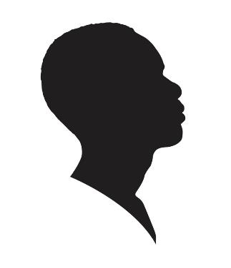
How to write Cuff Dix’s story?
Skilled Black workers striving for freedom, even when chained
Paradox of a revolution for liberty and equality while many Black people were enslaved
Dunmore’s Proclamation, Cuff Dix and Black Loyalists
We do not know what happened to Cuff Dix. In his book on iron works in early America John Bezis-Selfa reveals that in a listing of his 18
enslaved workers in 1780, Mark Bird did not include the name Cuff Dix. And Cuff Dix does not appear in any of the lists of Black people who
left with British forces at the end of the war. But those lists are incomplete, and like many runaways he may well have changed his name and appear
on one of the lists under another name. Perhaps Bird recaptured Dix and sold him to another enslaver? Perhaps Dix managed to create a life for
himself as a free Black man somewhere in America, or perhaps he was captured and enslaved elsewhere. Perhaps he died, either on the run or
with British forces. Or perhaps he succeeded, joining the British forces, and then eventually leaving with them at the end of the war as a free man.
We will never know, but Cuff Dix’s story still reveals a lot, and it would be possible to write about Cuff Dix in different ways.
We could write a narrative using all of these sources which focuses on the determination of skilled Black workers to be free, how even when
restrained by chains around their ankles or iron collars around their necks, they still escaped, even escaping from jail. Men like Dix
would have been punished for attempting escaping, quite possibly facing a severe whipping. And yet still he and others like him dared
to escape.
Or we could write a narrative that focuses on the paradox of the American Revolution being all about freedom and liberty and equality, while
yet denying that to enslaved Africans: the issue of the PA Gazette that includes both an advertisement for Dix and the ‘Declaration of the
Rights of the Inhabitants of the State of Pennsylvania’ could be central to this.
Or we could write something that focuses on Lord Dunmore’s Proclamation, and how Dix and many others like him sought to use the conflict
between America and Britain to achieve freedom. (And this might also include how enslavers like Mark Bird were aware of how
enslaved people thought and talked about Dunmore as their potential liberator).

Slide 16
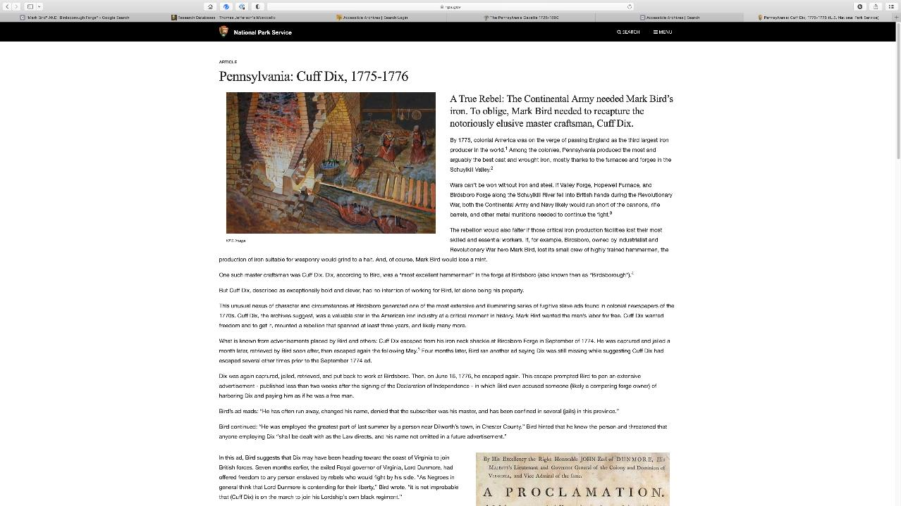
National Park Service
Cuff Dix is unusual in that his story has
attracted other historians and writers, so
it is possible to find out more about him
using the research that other people have
done. This is not true for most runaway
advertisements, and in many cases you
may well be the very first person in
centuries to try and find out more about
the individual identified in the
advertisement.

