Slide 1

Freedom Seeker case study 1
Molly, South Carolina, 1788

Slide 2
The following are freely available online collections of advertisements, many of them searchable.
“Freedom On The Move,” https://app.freedomonthemove.org/search
(more than 10,000 advertisements from 18th and 19th century North American newspapers).
“The Geography of Slavery in Virginia.” http://www2.vcdh.virginia.edu/gos/index.html
(advertisements from the Virginia Gazette).
“North Carolina Runaway Slave Notices, 1750-1865,” http://dlas.uncg.edu/notices/?t=3
(more than 5,000 North Carolina advertisements from 1751-1865).
“Runaway Slaves in Britain,” https://www.runaways.gla.ac.uk/database/table/
(more than 800 advertisements from English and Scottish newspapers, 1700-1780).
Collections of runaway advertisements from Philadelphia, Barbados, Grenada, and Jamaica
(several different datasets). https://repository.upenn.edu/exhibits/orgunit/mead
(downloadable PDF documents with scans of advertisements, under “Datasets from 2022”).
“Texas Runaway Slave Project,” https://digital.sfasu.edu/digital/collection/RSP
(more than 2,500 advertisements.

Slide 3
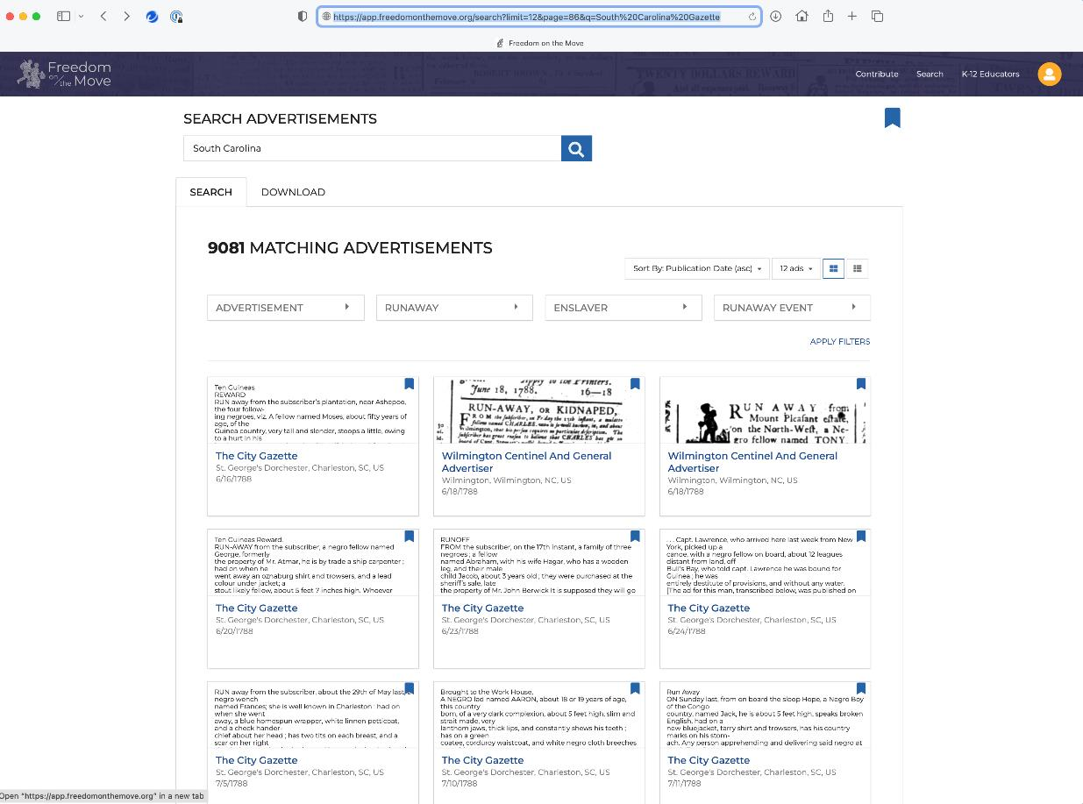
The Freedom on the Move
website is the largest single
Collection of North American
Advertisements for Freedom Seekers.
You can search by date or by place.

Slide 4
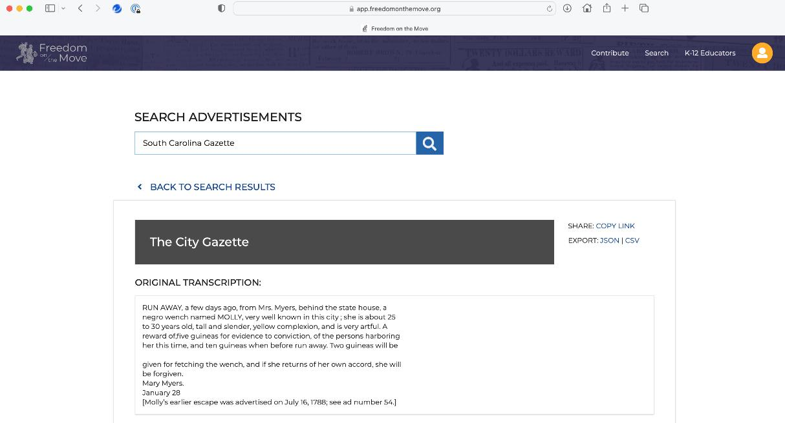
By entering ”South Carolina”
and looking for late-18th
Century advertisements,
It is possible to discover
items like the following
two advertisements.
You can search other places
and periods in this way.
These two advertisements for
the same young woman
were printed two years apart.

Slide 5
“Run Away, FOUR weeks ago, from Mrs. Meyers, behind the state-house, a negro wench named Molly, 25 years old, tall and slender, of a yellowish complexion, this country born; has a pass to look for cows up the path; artful and cunning, is pretty well known from her selling milk and garden stuff; had on when she run away, a white wrapper with long sleeves, a black coat flounced. Whoever will deliver her to her mistress, shall be handsomely rewarded, and if returns of her own accord she will forgive her.”
The City Gazette (St. George’s, Dorchester, South Carolina), July 16, 1788
These two advertisements are taken from the Freedom on the Move website.
“RUN AWAY, a few days ago, from Mrs. Myers, behind the state house, a negro wench named MOLLY, very well known in this city; she is about 25 to 30 years old, tall and slender, yellow complexion, and is very artful. A reward of five guineas for evidence to conviction, of the persons harboring her this time, and ten guineas when before run away. Two guineas will be given for fetching the wench, and if she returns of her own accord, she will be forgiven. Mary Myers.”
The City Gazette (St. George’s, Dorchester, South Carolina), January 28, 1790
Advertisements like these pose real problems. It may just be possible to find information about the enslaver,
Mrs. Mary Myers. But it will be almost certainly be impossible to learn anything more about Molly. These two
short notices, the first 91 words long, the second 87 words long, are probably the only surviving records of Molly
and her life. These few words are all we have to go on.

Slide 6
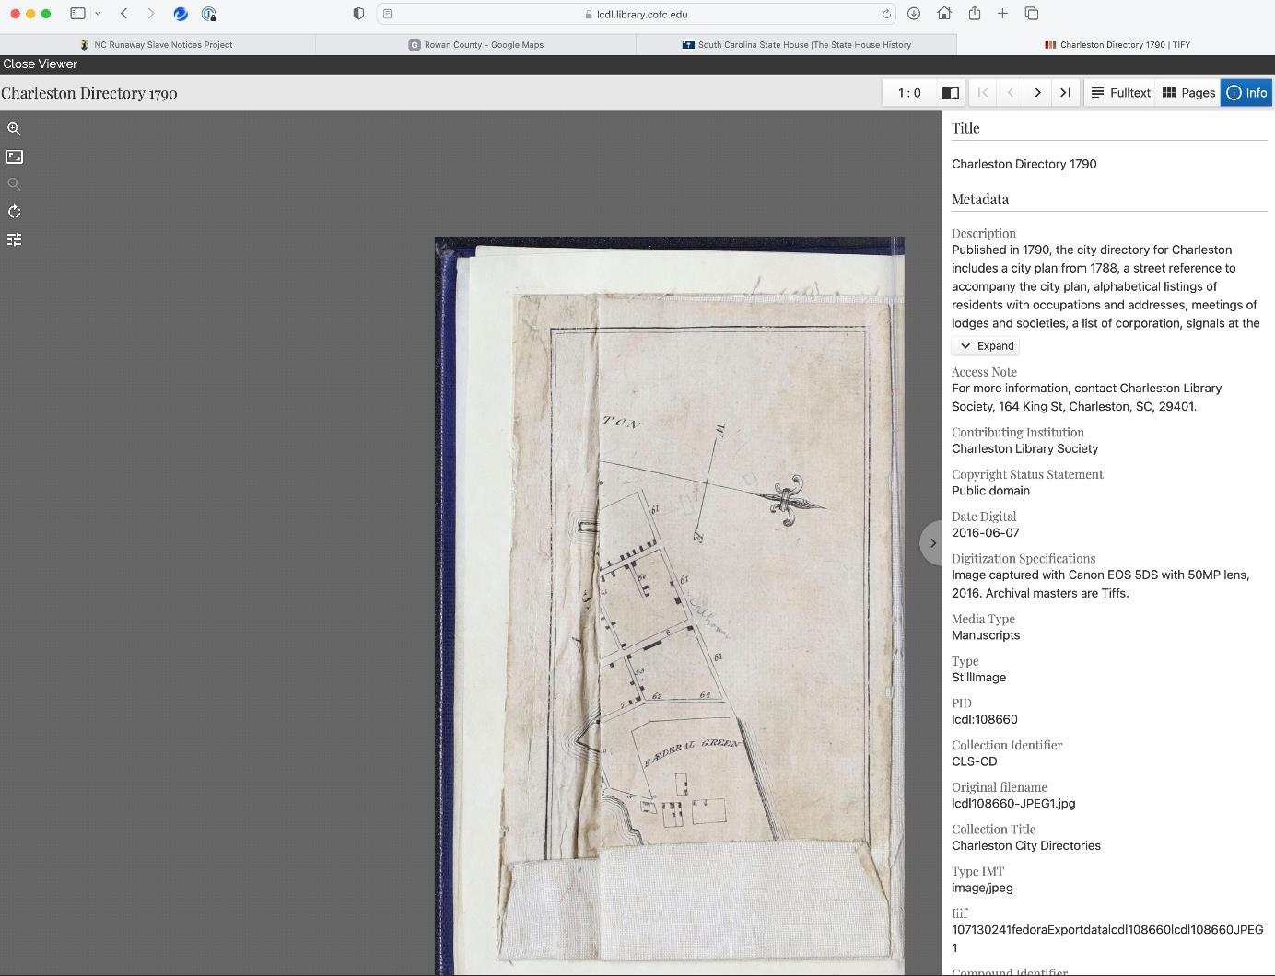
Google search for:
Charleston AND
directory AND 1790
You might also search for tax list or census.

Slide 7
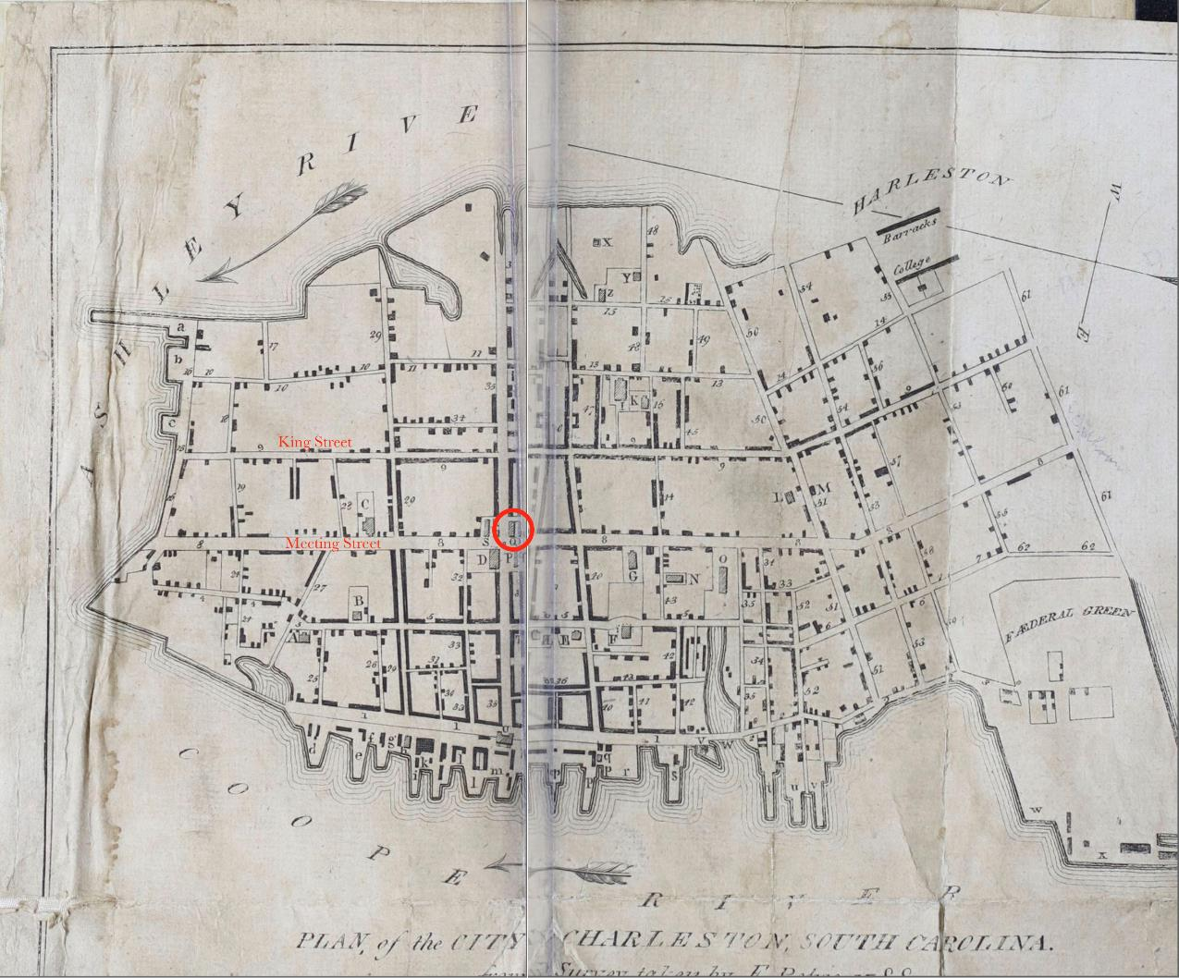
Map from 1790
Charleston
city directory
At the front of the directory is a map and a listing of major buildings. The first advertisement for Molly began with the words: “Run Away, FOUR weeks ago, from Mrs. Meyers, behind the state-house…” The State House is marked by Q, so we can see roughly where Molly, and Mrs Myers, lived.

Slide 8
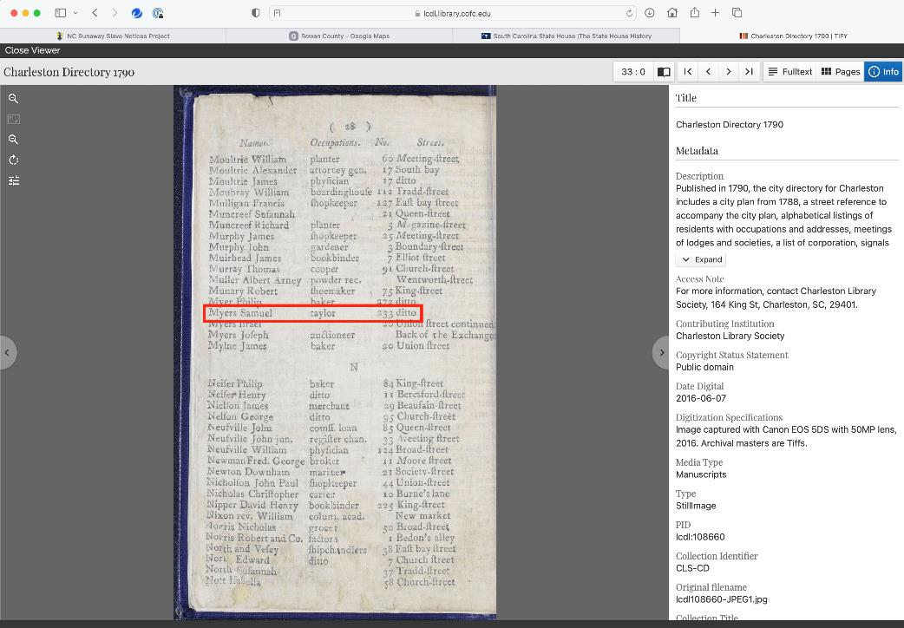
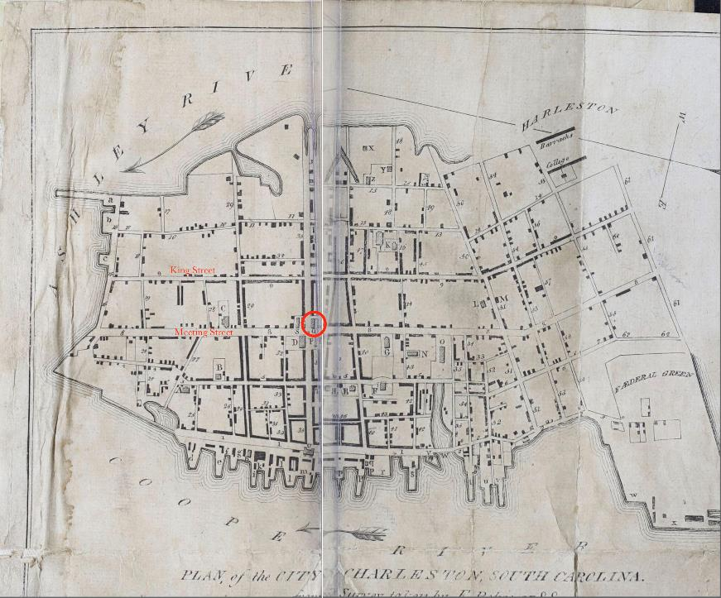
1790 Charleston city directory
Women aren’t often listed in directories of this period, but Samuel Myers, a taylor, is listed as having his business (and probably his
home) on King Street. The back of the house could have backed on to the area around the State House, so it is quite possible that
Mary Myers was either the mother or the wife of Samuel Myers. We can’t know for sure, but this is quite possible since the three
other people named Myers were on Union Street or by the Exchange, and these were by the waterfront some distance away from
the site mentioned in the advertisement.

Slide 9
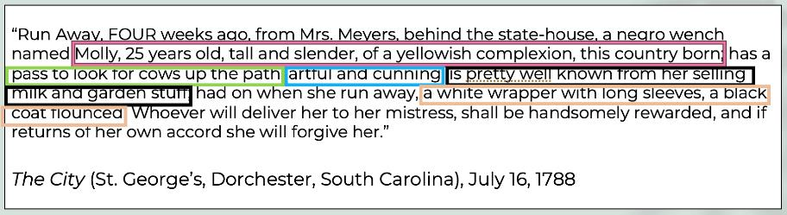
So we are left with what little we have found out, and the runaway advertisements themselves.
Molly is known by just this name. She has no last name, and her name has been defined and limited by slavery.
When she escaped in June 1788 Molly was 25 years old, and when she escaped again two years later she was ’25 to 30’.
Molly was “this country born” meaning she was born in America. Her “yellowish complexion” reflects the language often used
to describe enslaved people who were mixed race, so it is quite possible that her father had been a White man.
Molly had a written pass, giving her permission to be out and about, looking for cows that may have strayed from the yard and
wandered towards open country. Molly was almost certainly illiterate, but she might still have been able to take
advantage of this pass to go off on her own to wherever she wanted to go.
And clearly Molly knew her way around Charleston and the vicinity, because part of her work was selling milk and other produce.
Molly was dressed quite simply when she escaped in 1788. Looking at some of the articles on clothing, and some google
searching for terms, shows that “a white wrapper with long sleeves” was a kind of wrap-around garment (like a robe)
worn over a dress or other clothing. Her black coat was “flounced”, meaning it had fabric added (usually to the hemline)
to exaggerate movement. This is interesting, because “flouncing” has no function: it is a fashionable addition to clothing,
something intended to attract the eye and make the wearer look good. Remember, Samuel Myers was a tailor: was this
a hand-me-down from the Myers family members? Or had Molly created this herself?

Slide 10
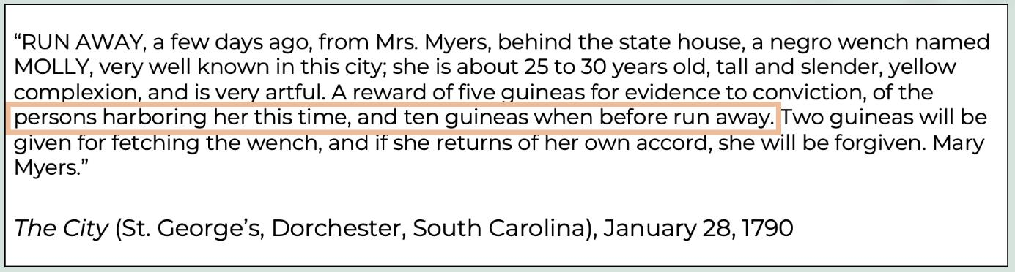
Dates. The first advertisement appeared one month after Molly had escaped. It seems that Mrs. Myers had expected Molly
to return of her own accord, and perhaps this had happened before. Enslavers often allowed enslaved people occasional short periods away, a sort of time-out that helped the enslaved by having time to themselves, with family and friends. But after a certain point this became escape, and Mrs. Myers clearly intended to recapture Molly.
And Molly was recaptured, or chose to return, because the second advertisement 18 months later refers to the previous
escape. And this second advertisement makes clear that Mrs. Myers believes that somebody is harboring or
concealing Molly, and that it was the same person who concealed her in 1788. In fact Mrs. Myers promises a sizeable
reward if evidence of who this is can be secured. Who might this person be? It may be a White person, but it is more
likely that this was a Black person, perhaps free or enslaved. Charleston had a sizeable Black population, including
some free Black people. Molly was a young woman in the prime of her youth: perhaps she was escaping to be with
a partner, who concealed her as best he could.
In both advertisements Molly is described as “artful”, and in one advertisement as “cunning.” These are negative,
derogatory terms, suggesting Molly was sneaky, conniving, and often up to no good. But think of this from Molly’s
  perspective. Perhaps she was simply good at trying to look after herself and her interests even while enslaved. What
  was self-interest and self-preservation to Molly might have looked like artful and cunning behavior to Mary. Myers.

Slide 11
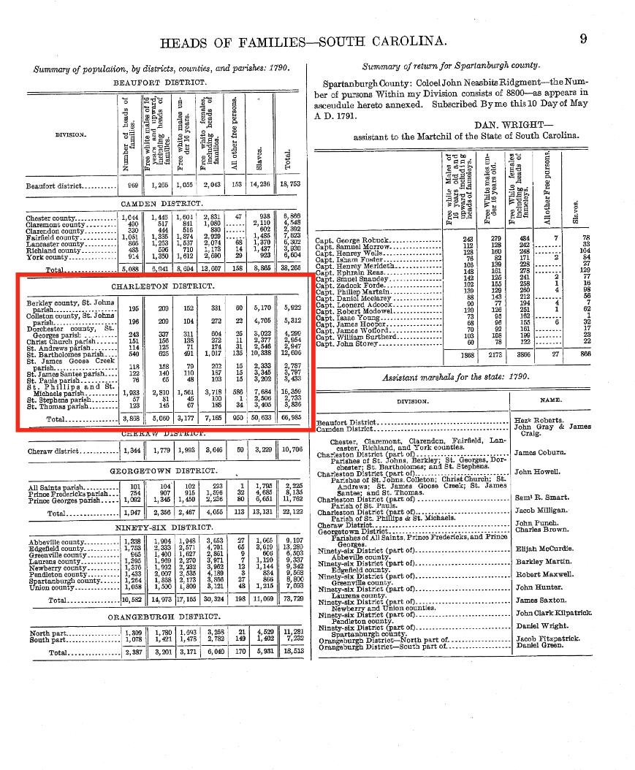
1790 Federal Census https://www.census.gov/library/publications/1907/dec/heads-of-families.html
There is no suggestion that Molly has tried in the past or
might try this time to get away from Charleston. The 1790
Federal census revealed that a total of 66,985 people lived
in the Charleston district, and of these 50,633 were
enslaved Black people. Although dangerous, of course, it
was quite possible for an enslaved person to remain at
liberty, hidden in plain sight, blending into the city’s large
Black population.

Slide 12
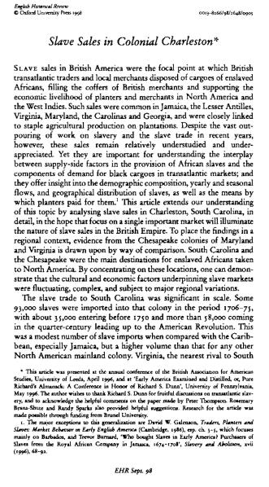
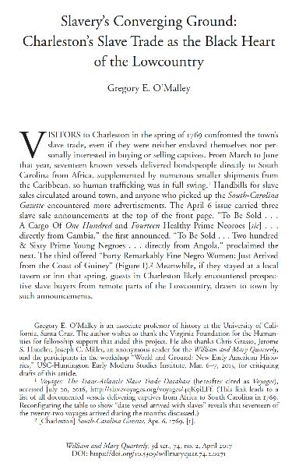
Kenneth Morgan, “Slave
Sales in Colonial Charleston,”
English Historical Review,
113 ((1998), 905-927.
Gregory O’Malley, “Slavery’s
Converging Ground,” William
& Mary Quarterly 74 (2017),
271-302.
So, the next thing to do is some research and reading about what
slavery was like in Charleston and South Carolina in the late 18th century.
You can start with the listing of books and articles in the bibliography,
but then do some searching via Google Scholar for things like
Charleston AND household slavery.
Articles like these two reveal interesting background: 93,000 enslaved
Africans were brought into South Carolina between 1706 and 1775,
almost all of them into Charleston, which was the largest slave-importing
port in America at the time of the revolution. While many of these went
to work in the interior on plantations, Charleston was a hub through
which many enslaved Africans passed, and slave sales were a common,
almost every day occurrence. We can think about this felt to enslaved people in Charleston, even if like Molly they had been born in America: clearly they knew that they and every other enslaved person were always at risk of being sold. In fact more enslaved Africans came into America through Charleston than any other city, probably about 40% of the total.

Slide 13
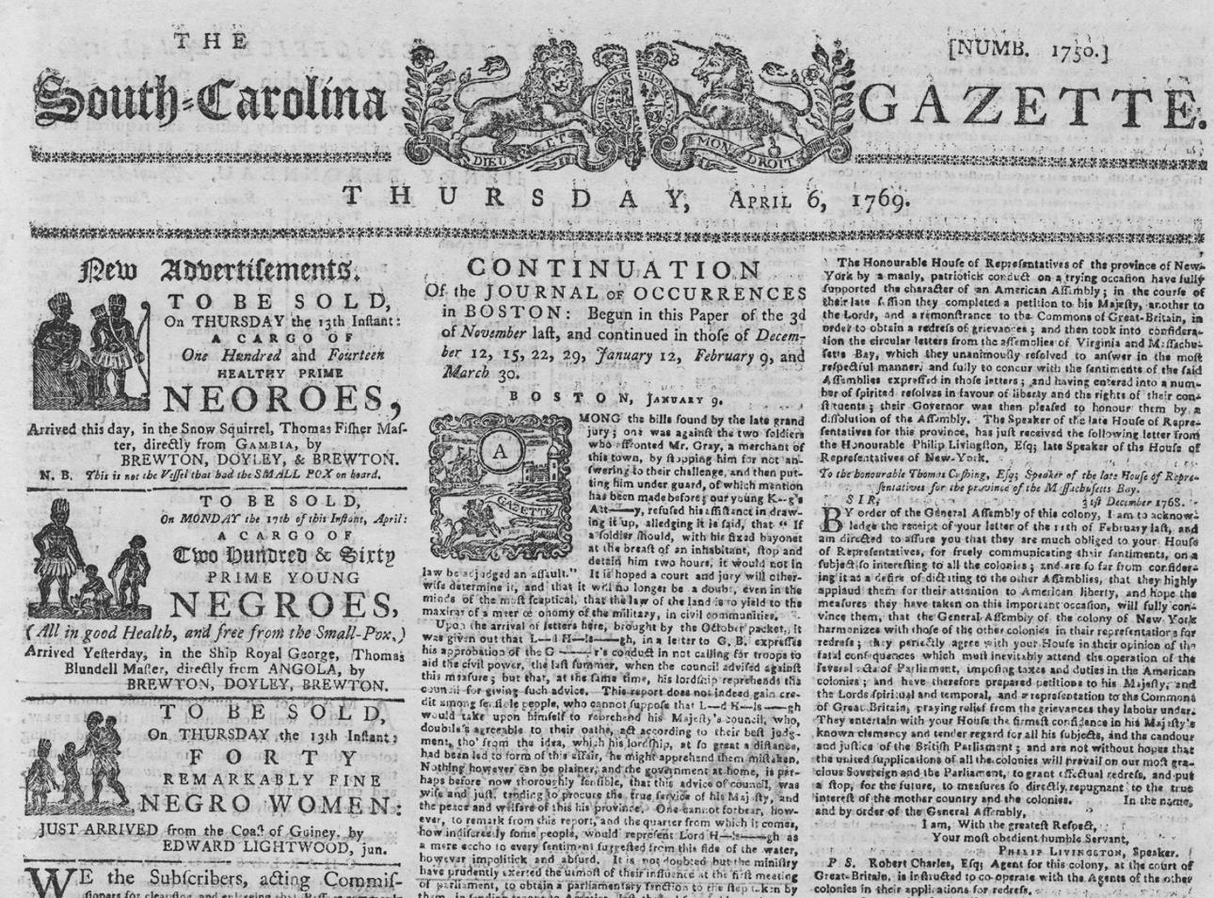
Indeed, the newspapers that included
runaway slave advertisements also had
many advertisements for the sale of
shiploads of newly arrived Africans.

Slide 14
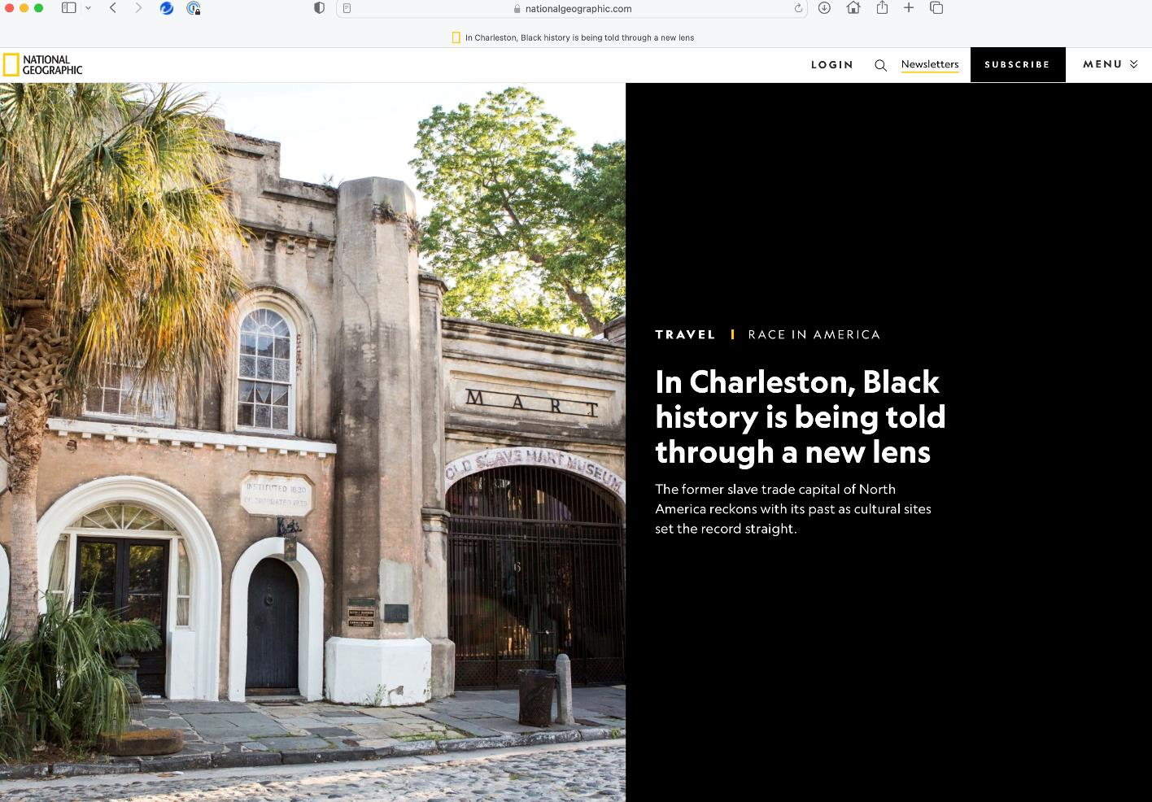
You can get a sense of this not
just from academic articles but
also more popular history, like
this National Geographic
article, and the website of the
Old Slave Mart Museum on the
site of the place where enslaved
people were bought and sold in
Charleston.

Slide 15
reading, research, and imagination: a (hi)story for Molly
What do we actually know?
her name
that she was about 25 when she first escaped, perhaps about 27 the second time
she was American-born, and quite possibly to an enslaved mother and White father
she lived in Charleston, and appears to have worked in the household of Mary Myers, sometimes walking around the Charleston area selling milk and produce from Meyer’s garden.

Slide 16
reading, research, and imagination: a (hi)story for Molly
What can we presume?
That she was skilled at looking after herself and her interests as best she could (“artful” and “cunning” in the eyes of Mrs. Myers)
That she was free for at least a month the first time, and that she escaped again 18 months later
That she may have taken refuge with family and friends in or near the city, perhaps an enslaved or free Black partner
That she was willing to risk a lot to do this, including severe physical punishment, sale, and even execution
That she may have been driven to escape by different motives, such as a desire to be free, a desire to be with a partner, a need to escape from violence and abuse (perhaps sexual) or imagine

Slide 17
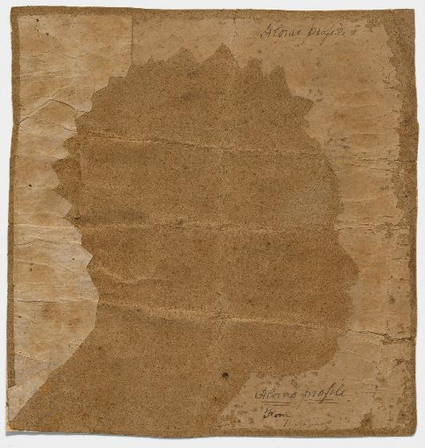
Writing Molly’s (hi)story)
In a way writing Molly’s (hi)story will be about researching and learning about the lives of all enslaved women in late 18th century Charleston and South Carolina, and then imagining Molly in that context. So, for example, you might read and research on the formation of Black families in Charleston, and how enslaved and free Black people tried to create and maintain families against the constant threat of sale and the forced division of families, as well as the constant threat of sexual abuse of enslaved women by White men. You could then write about how this may have been the context for Molly’s escape, along the following lines.

Slide 18
Writing Molly’s (hi)story): one approach
Molly may well have been inspired to escape in order to be with her partner, most likely a free Black man or perhaps an enslaved Black man in or near Charleston. Her enslaver, Mary Meyers, described Molly as “artful and cunning,” demeaning her as a deceitful and untrustworthy person of color. But this may simply have been Molly’s calculated decisions and actions designed to give her time with the person or people she loved. Mary Meyers gave Molly a pass so that she could walk around Charleston selling milk and garden produce, and Molly may well have taken advantage of this to do what she wanted, including spending time with others: to Mary Meyers this would have been “artful and cunning,” but to Molly it would have been something very different.
Escaping, and remaining at liberty, was very risky. Other advertisements referred to the fact that freedom seekers who remained free for extended periods could be captured dead or alive, and that the White person who killed such a freedom seeker would face no charges. How desperate must people like Molly have been to face this risk? Was she inspired not just by a desire to be with a partner or other people, but also by a fear of physical violence and even sexual abuse while in Mrs. Meyer’s household? Violence towards enslaved servants, by White women as well as men, was common, and the rape of enslaved women by White men was routine: indeed, it is possible that Molly, with her “yellowish complexion,” was the child of just such a rape.

